Slide 1
Real-time classroom comparison of structures and NMR spectra using Jmol/JSpecView and nmrdb
Robert Hanson, St. Olaf College
Robert Lancashire, U. of the West Indies
Luc Patiny, École Polytechnique Fédérale de Lausanne
CHED 39
249th ACS National Meeting
Denver, Colorado
March 22, 2015

Slide 2
Question: What do you imagine to be the look and feel of the organic chemistry classroom in 2025?
Will we still be using printed textbooks?
Will we be using plastic models?
What other resources will we be using?

Slide 3
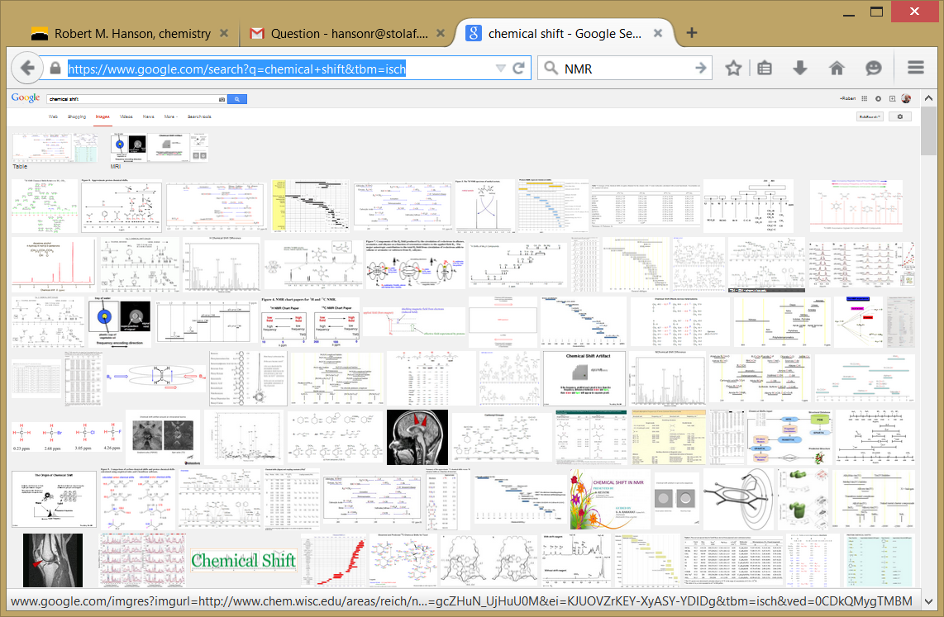
Question: Do you use Google Images in class?
https://www.google.com/search?q=chemical+shift&tbm=isch

Slide 4
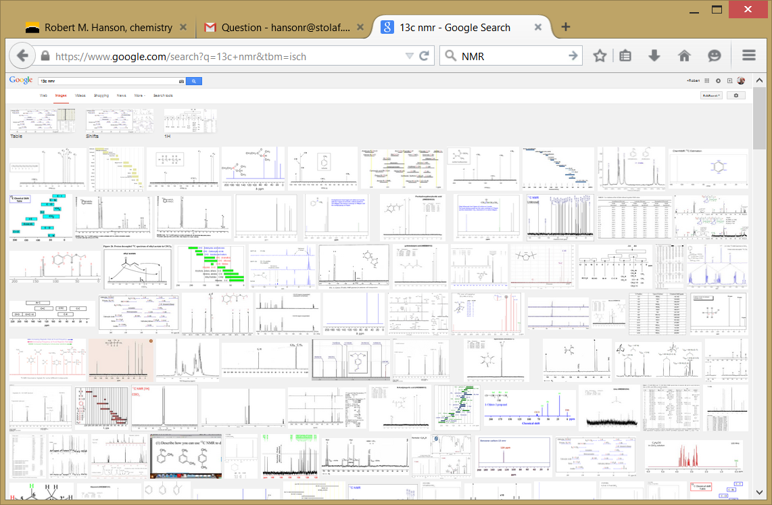
Question: Do you use Google Images in class?
https://www.google.com/search?q=13c+nmr&tbm=isch

Slide 5
Context – St. Olaf
St. Olaf College – residential, liberal arts
3000 students; undergraduate only (750/yr)
300 students in first-year chemistry program
160 students take organic (3 sections+summer)

Slide 6
Context – Chemistry 247
Standard 2-semester course
Textbook: Smith, 4th ed.
Early introduction of NMR, MS, and IR
1: Structure and Bonding
2: Acids and Bases
3: Introduction to Organic Molecules and Functional Groups
4: Alkanes
5: Stereochemistry
14: Nuclear Magnetic Resonance Spectroscopy
13: Mass Spectrometry and Infrared Spectroscopy
6: Understanding Organic Reactions
7: Alkyl Halides and Nucleophilic Substitution
8: Alkyl Halides and Elimination Reactions
9: Alcohols, Ethers, and Epoxides
10: Alkenes

Slide 7
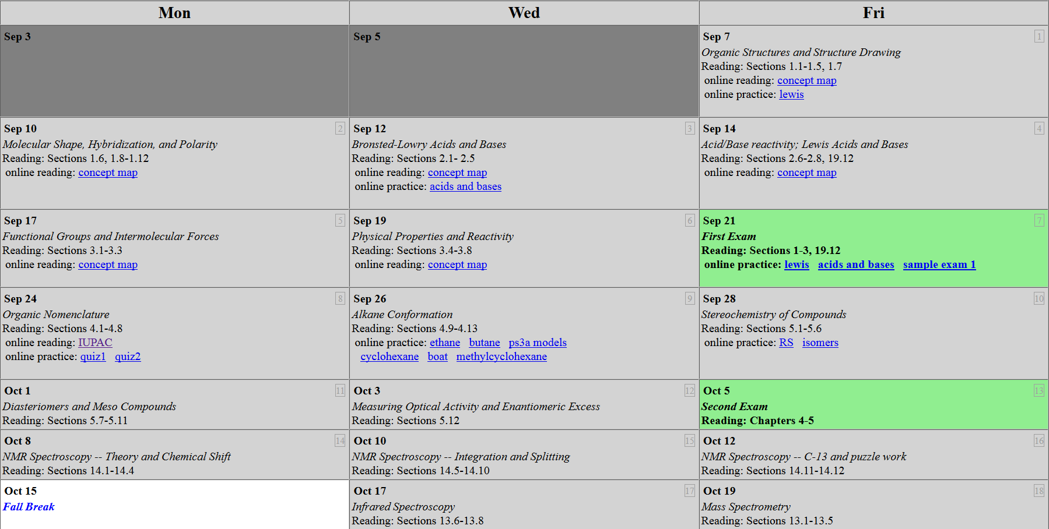
Context – Chemistry 247
(Fall 2012, Hanson)

Slide 8
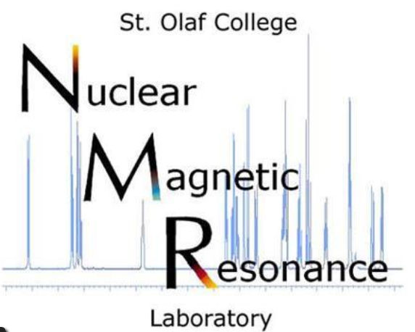
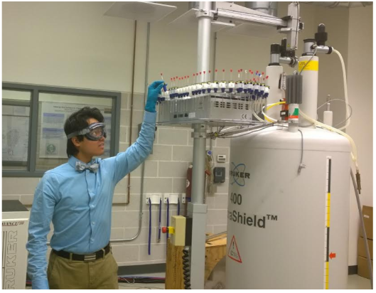
Context – Synthesis Lab
Fully robotic 400 MHz
NMR facility (2003)
Routinely processes 3000+
student samples per year
http://chemapps.stolaf.edu/nmr

Slide 9
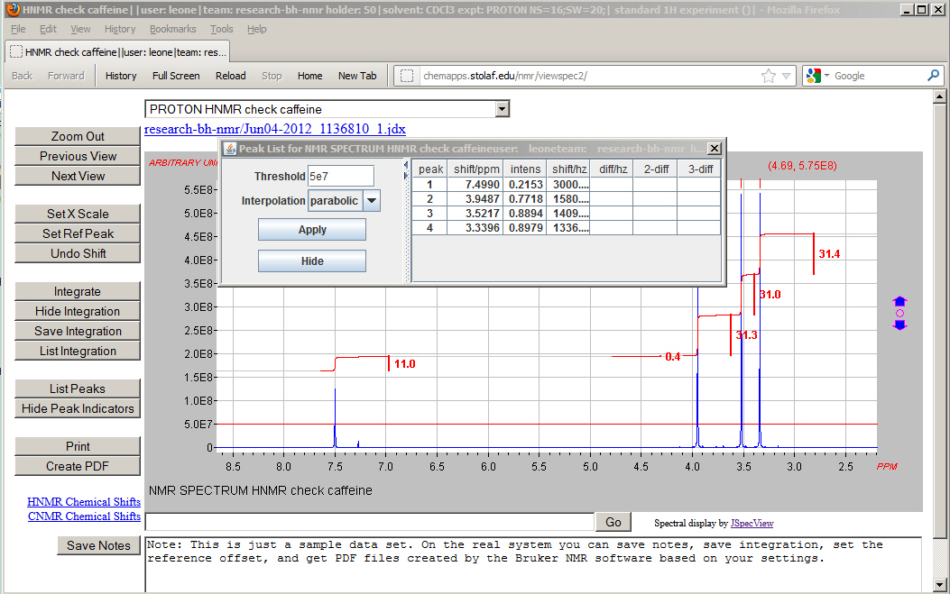
JSpecView Front-End for St. Olaf NMR Facility (2012)
http://chemapps.stolaf.edu/nmr/viewspec2.htm (Java)

Slide 10
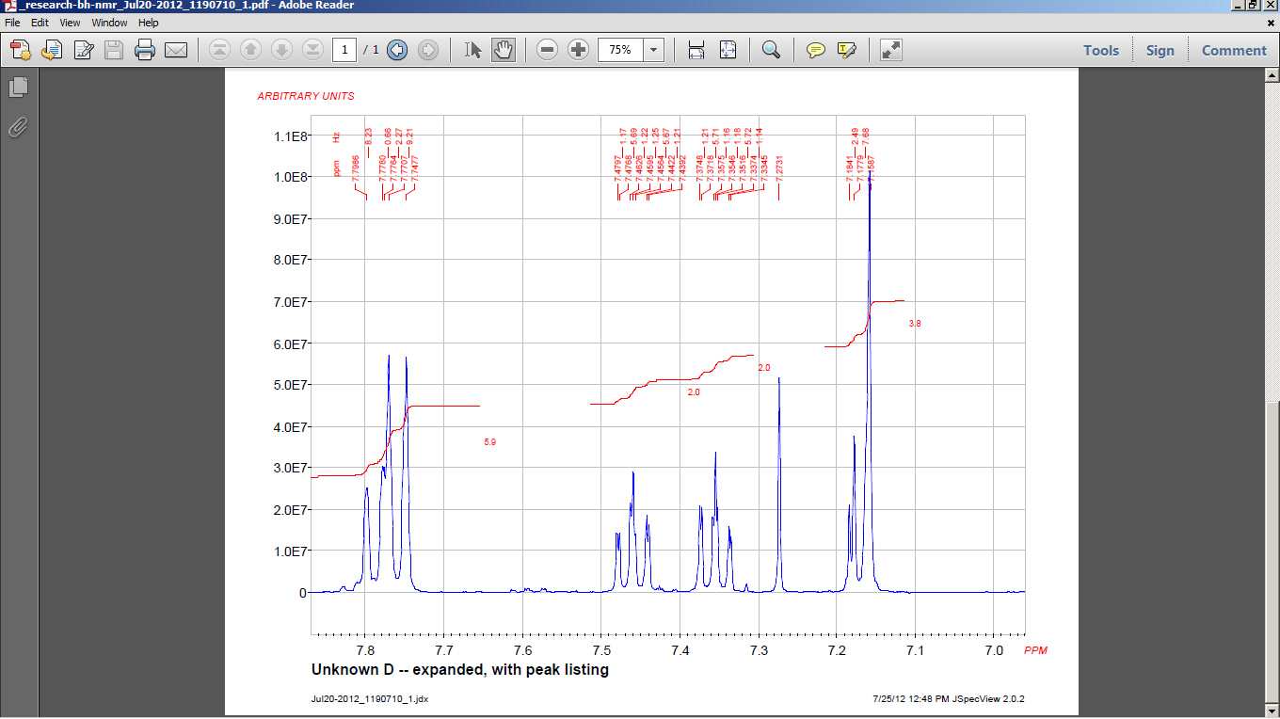
JSpecView Front-End for St. Olaf NMR Facility (2012)
http://chemapps.stolaf.edu/nmr/viewspec2.htm (Java)

Slide 11
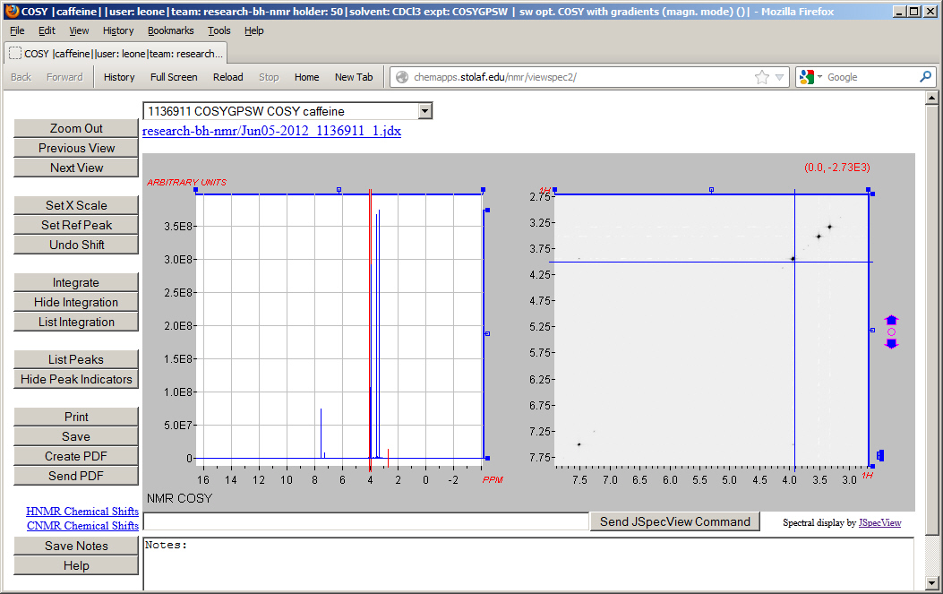
JSpecView Front-End for St. Olaf NMR Facility (2012)

Slide 12
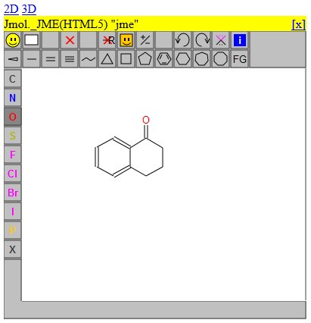
Real-Time access to 3D chemical structures (2013)
JSmol/JSME integration
http://chemapps.stolaf.edu/jmol/jsmol/jsmetest.htm

Slide 13
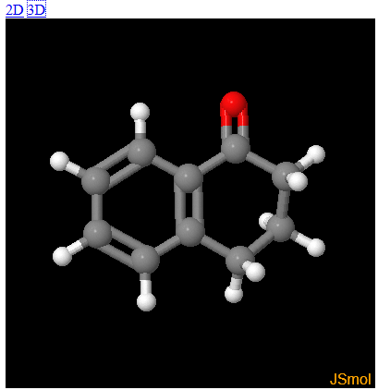
Real-Time access to 3D chemical structures (2013)
Allows easy generation of 3D structures from 2D drawings
http://chemapps.stolaf.edu/jmol/jsmol/jsmetest.htm

Slide 14
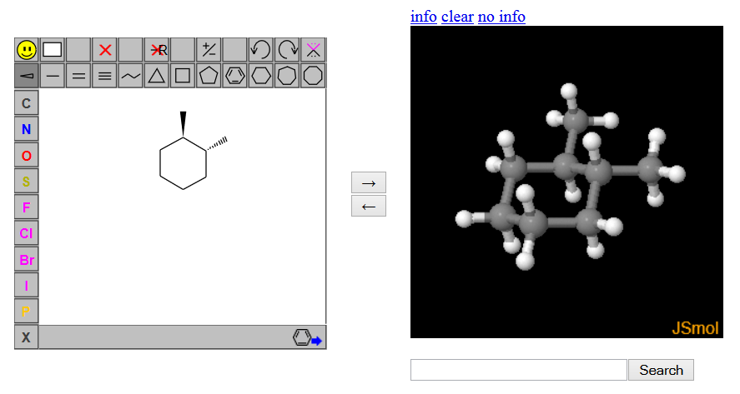
Real-Time access to 3D chemical structures (2013)
Allows easy generation of 3D structures from 2D drawings
http://chemapps.stolaf.edu/jmol/jsmol/jsmetest2.htm

Slide 15
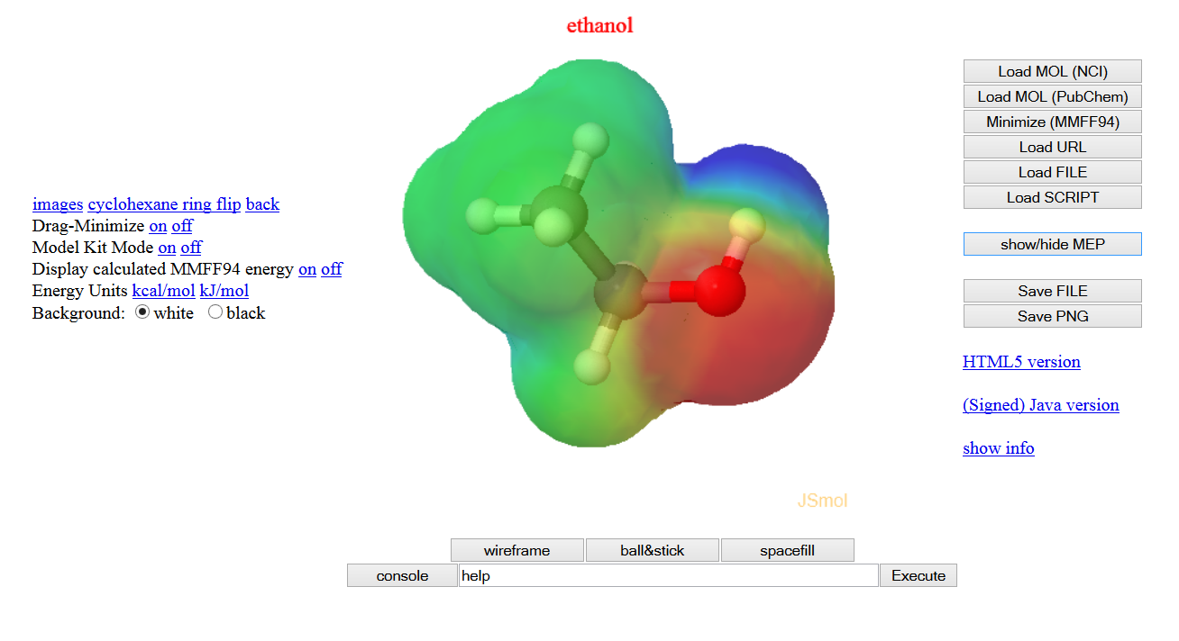
Real-Time access to 3D chemical structures (2013)
Easy depiction of electrostatic potentials from chemical names
http://chemapps.stolaf.edu/jmol/jsmol/simple2.htm

Slide 16
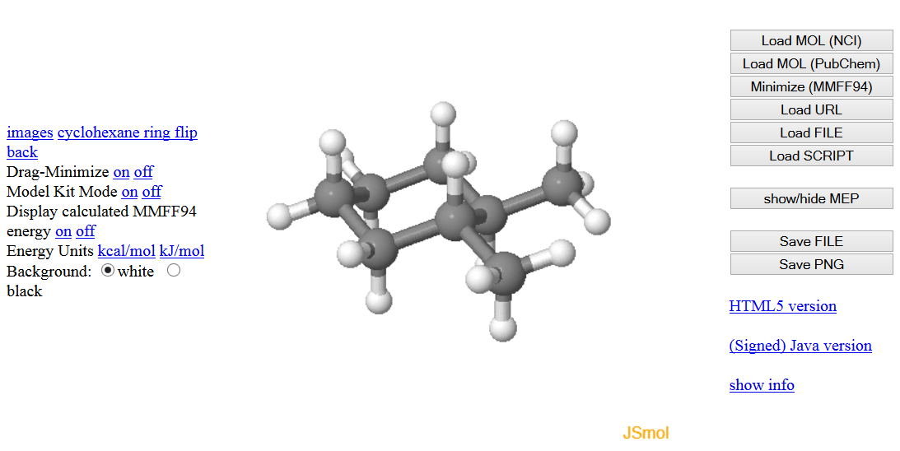
Real-Time access to 3D chemical structures (2013)
Easy building and stereochemical tweaking of 3D models
http://chemapps.stolaf.edu/jmol/jsmol/simple2.htm

Slide 17
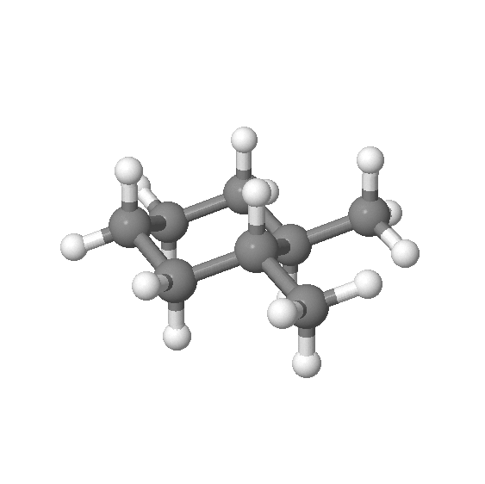
Real-Time access to 3D chemical structures (2013)
Easy building and stereochemical tweaking of 3D models
http://chemapps.stolaf.edu/jmol/jsmol/simple2.htm

Slide 18
Real-Time NMR spectrum prediction
The idea:
Start with 2D drawing or chemical name
Analyze structure and predict the NMR spectrum
Allow for correlated interaction among 2D, 3D, and spec

Slide 19
Real-Time NMR spectrum prediction
The idea:
Start with 2D drawing or chemical name
Analyze structure and predict the NMR spectrum
Allow for correlated interaction among 2D, 3D, and spec
Use readily available cloud-based tools to do this.

Slide 20
Real-Time NMR spectrum prediction
The idea:
Start with 2D drawing or chemical name
Analyze structure and predict the NMR spectrum
Allow for correlated interaction among 2D, 3D, and spec
Use readily available cloud-based tools to do this.
Use fast real-time communication among web sites in Fredrick (Maryland), Lausanne (Switzerland), and Lisbon (Portugal)

Slide 21
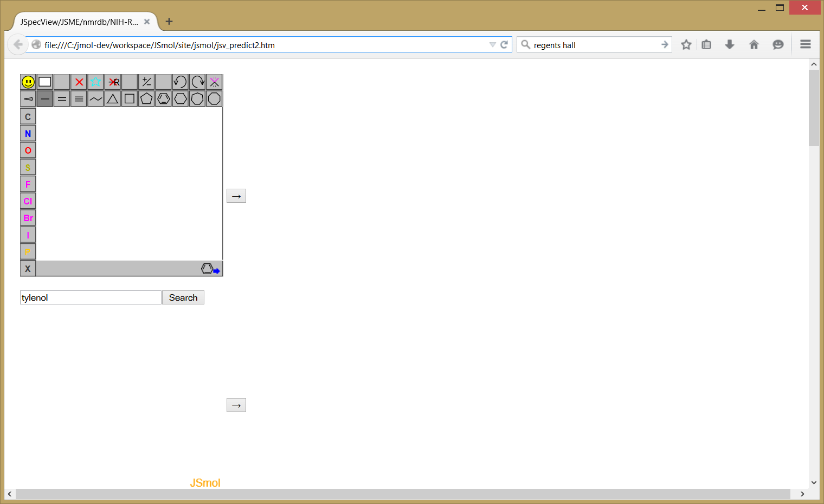
Real-Time NMR spectrum prediction
http://chemapps.stolaf.edu/jmol/jsmol/jsv_predict2.htm

Slide 22
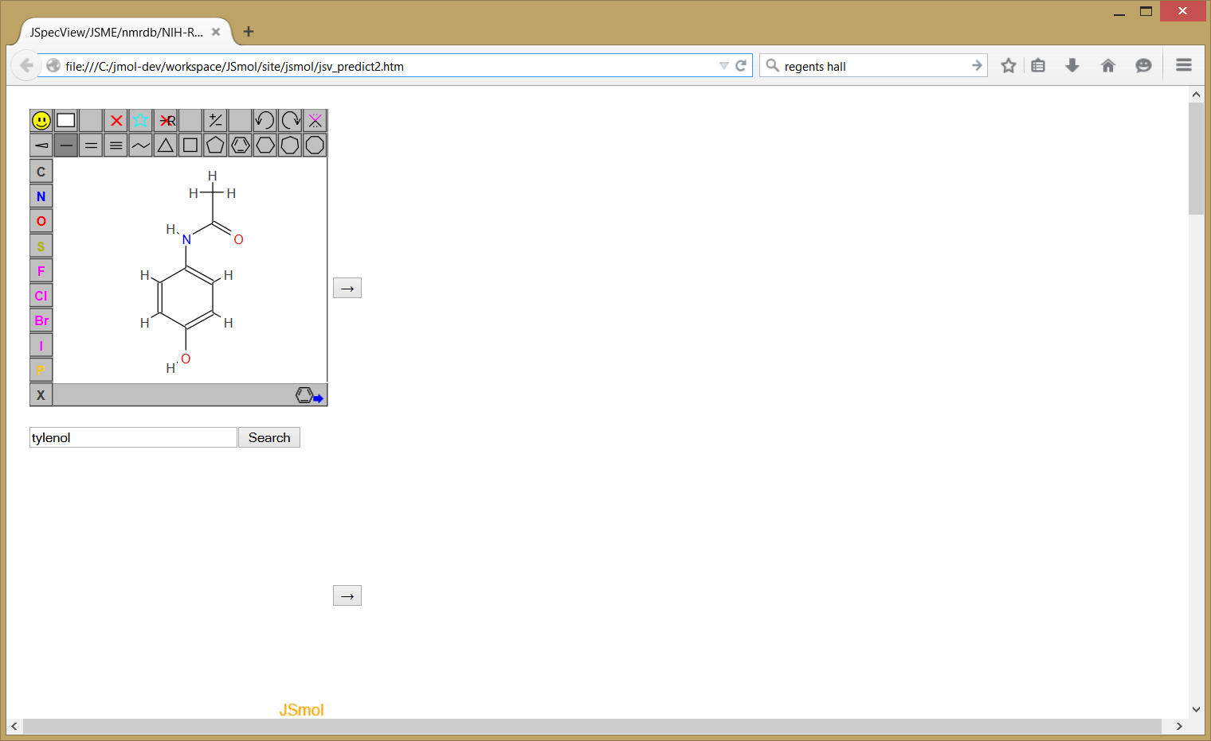
Real-Time NMR spectrum prediction
http://chemapps.stolaf.edu/jmol/jsmol/jsv_predict2.htm

Slide 23
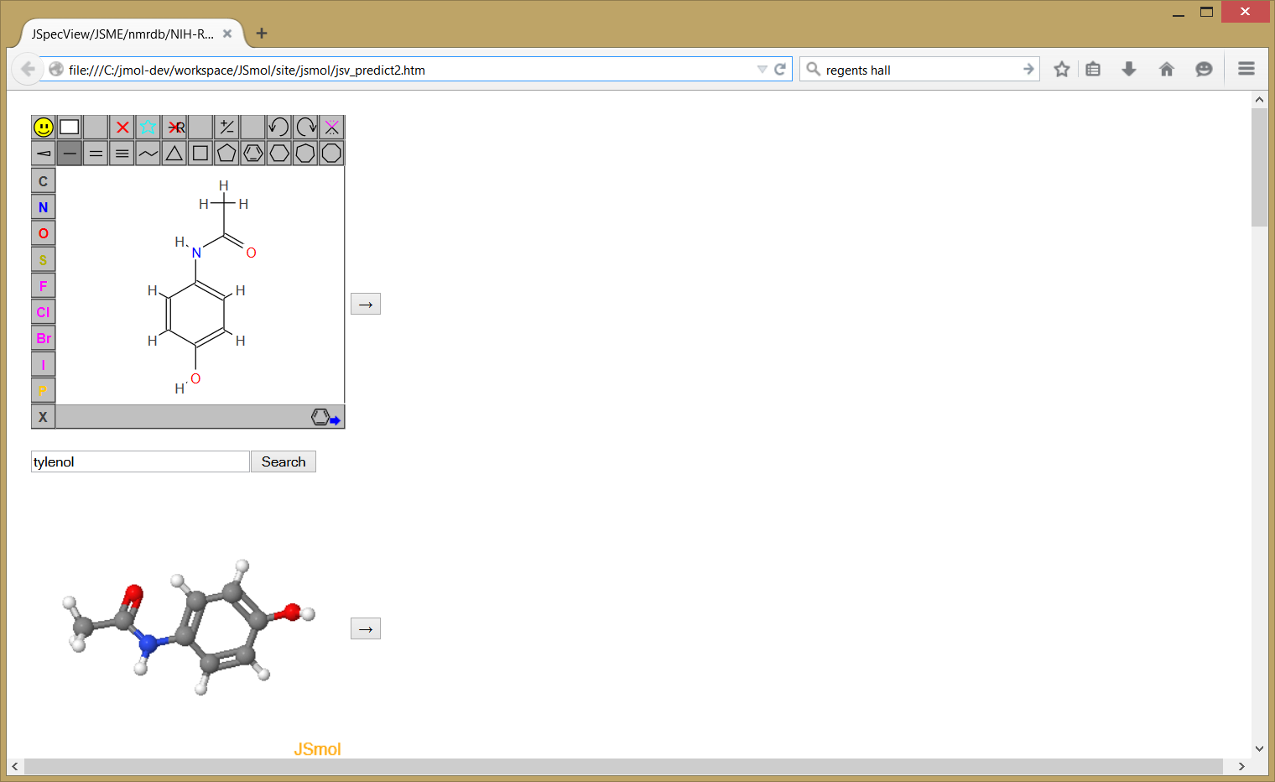
Real-Time NMR spectrum prediction
http://chemapps.stolaf.edu/jmol/jsmol/jsv_predict2.htm

Slide 24
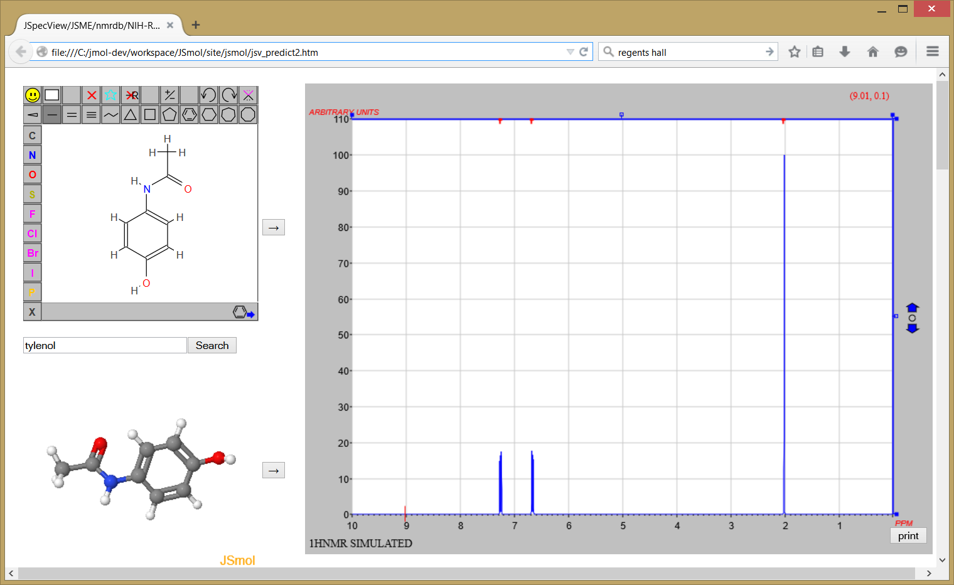
Real-Time NMR spectrum prediction
http://chemapps.stolaf.edu/jmol/jsmol/jsv_predict2.htm

Slide 25
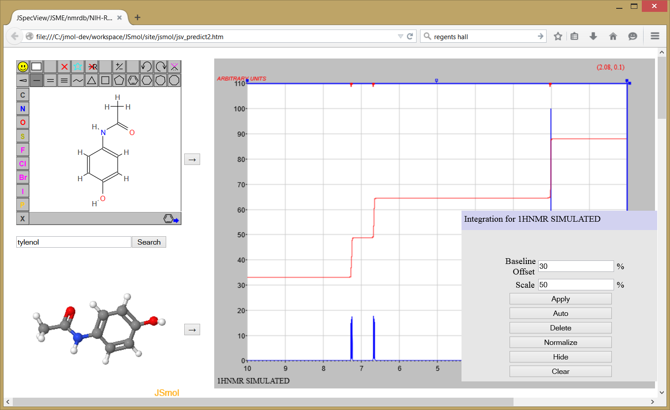
Real-Time NMR spectrum prediction
http://chemapps.stolaf.edu/jmol/jsmol/jsv_predict2.htm

Slide 26
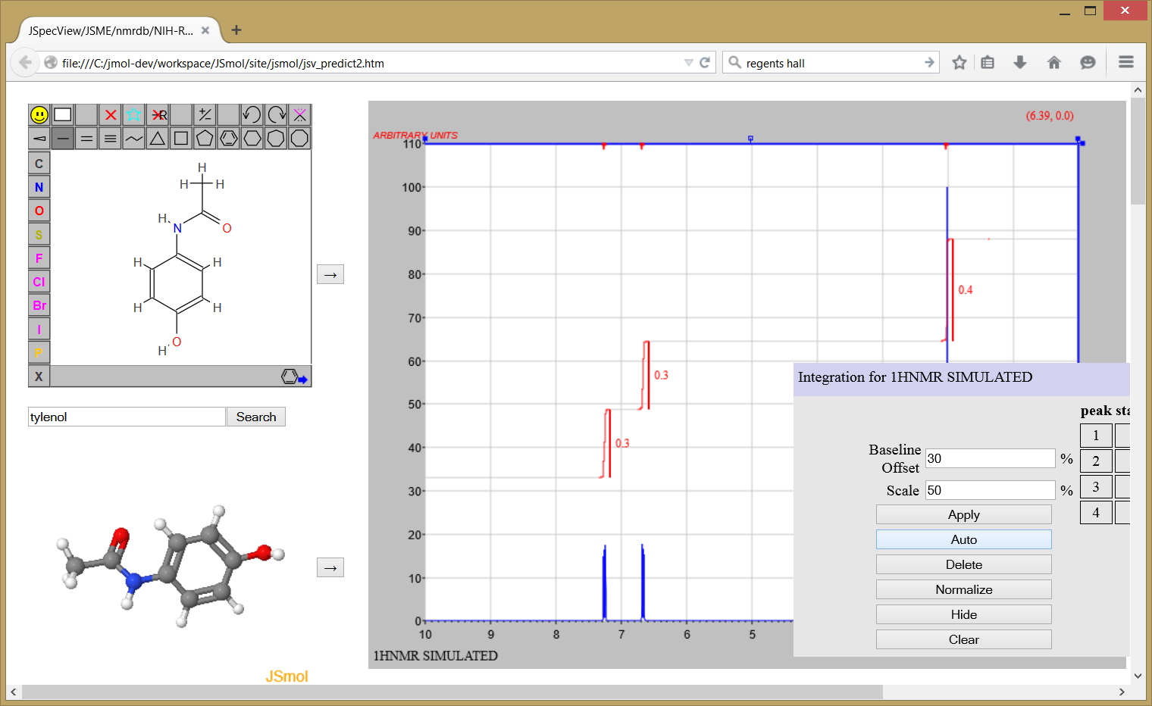
Real-Time NMR spectrum prediction
http://chemapps.stolaf.edu/jmol/jsmol/jsv_predict2.htm

Slide 27
Real-Time NMR spectrum prediction
http://chemapps.stolaf.edu/jmol/jsmol/jsv_predict2.htm

Slide 28
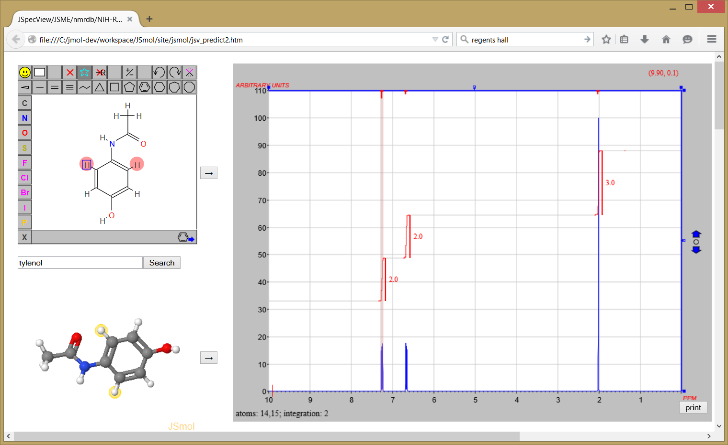
Real-Time NMR spectrum prediction
http://chemapps.stolaf.edu/jmol/jsmol/jsv_predict2.htm

Slide 29
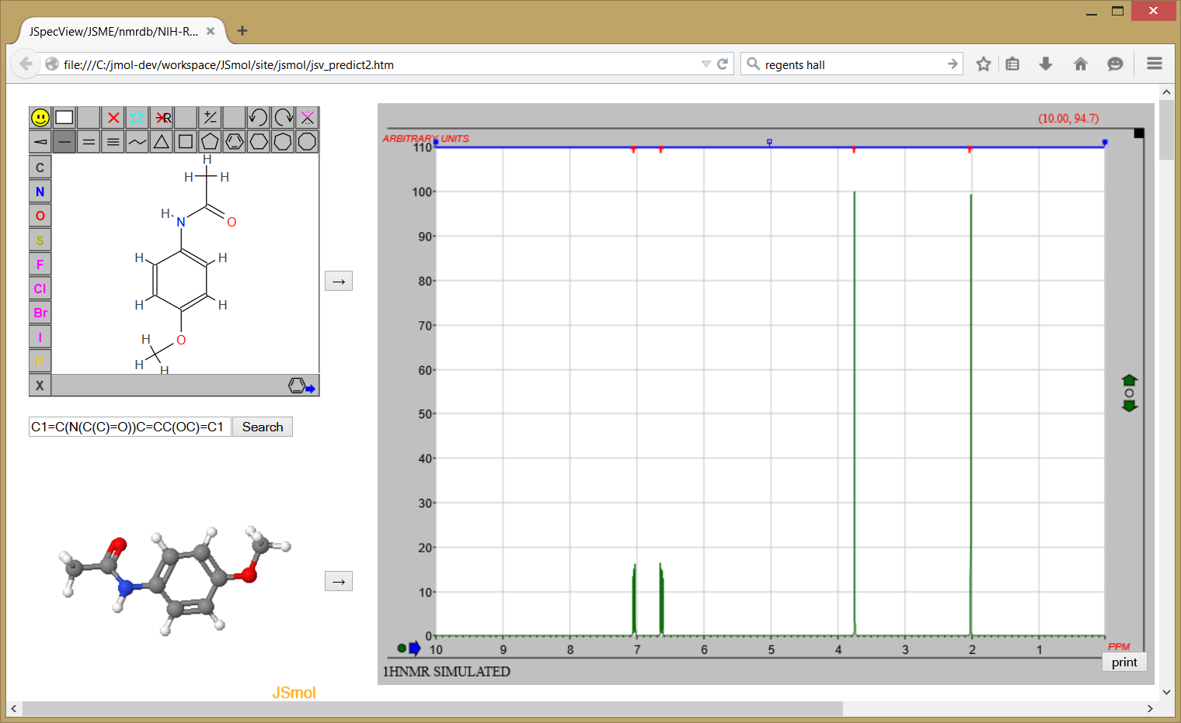
Real-Time NMR spectrum prediction
http://chemapps.stolaf.edu/jmol/jsmol/jsv_predict2.htm

Slide 30
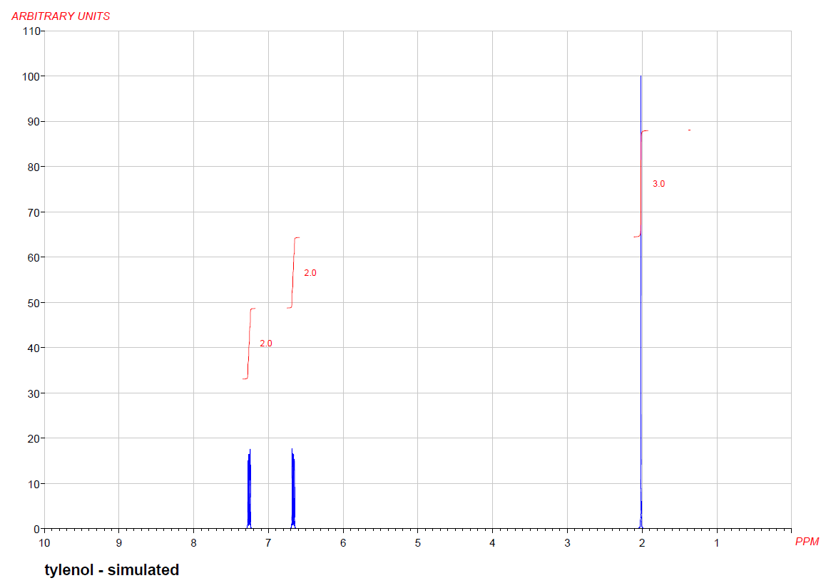
Real-Time NMR spectrum prediction
http://chemapps.stolaf.edu/jmol/jsmol/jsv_predict2.htm

Slide 31
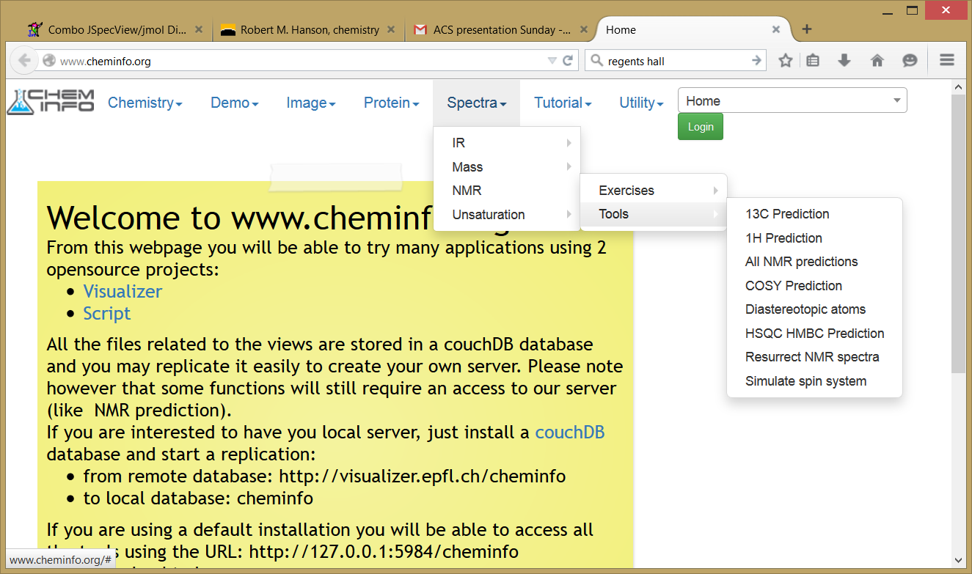
Prediction of 13C and 2D spectra (LP)
www.cheminfo.org

Slide 32
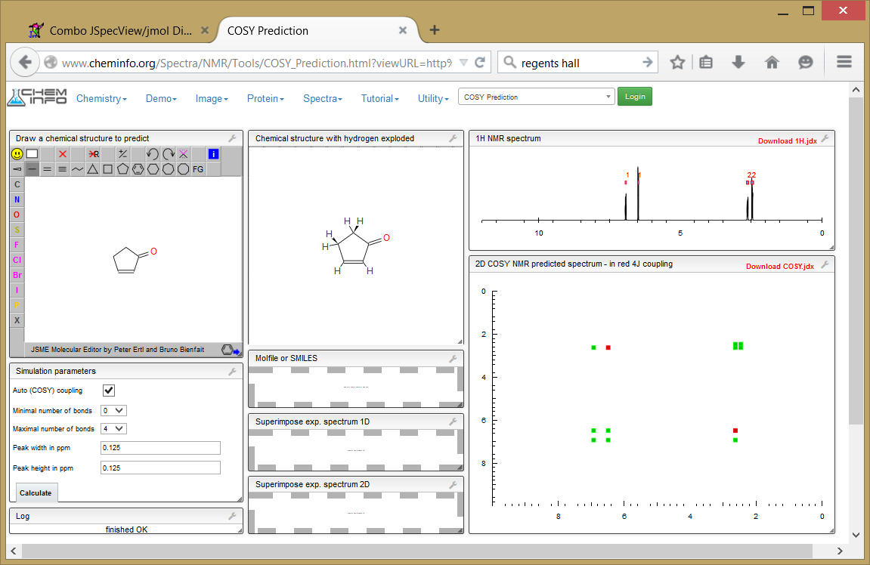
Prediction of 13C and 2D spectra (LP)
www.cheminfo.org

Slide 33
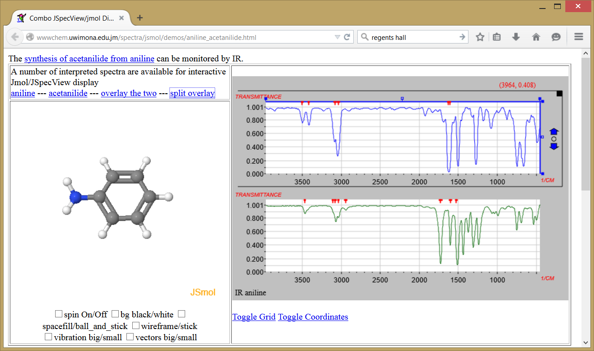
Interactive IR analysis (RL)
http://wwwchem.uwimona.edu.jm/spectra/jsmol/demos/aniline_acetanilide.html

Slide 34
Welcome to the age of the internet as a utility!

Slide 35
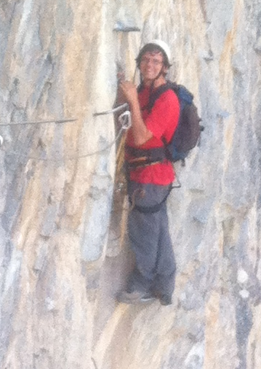
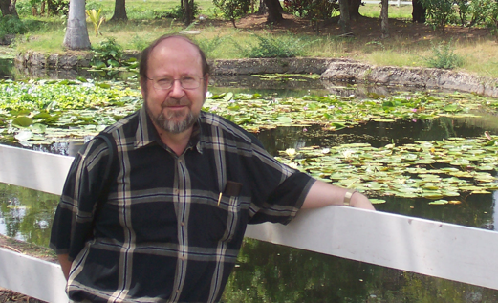
Thank you!
Special thanks to:
Marcus Sitzmann (NCI)
Zhou Renjian (J2S)
Peter Ertl (JSME)
St. Olaf College

Slide 36
headed
here
via ferrata, near
Lausanne,
Switzerland
Luc’s son

