Slide 1
Proposed application of the IUPAC FAIRSpec Finding Aid for standardized repository data introduction and delivery of metadata via an API
ACS National Meeting, Mar. 26, 2023
Robert M. Hanson, Mark Archibald, Ian Bruno, Stuart J. Chalk, Anthony N. Davies, Damien
Jeannerat, Robert J. Lancashire, Jeff Lang, Henry S. Rzepa
IUPAC Project 2019-031-1-024
Division of Chemical Information: Framing FAIR: Scientific Research Data Sharing Policies, Frameworks and Principles

Slide 2
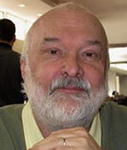
Bob Hanson
Damien Jeannerat
FAIRSpec PROJECT TEAM
IUPAC Project: 2019-031-1-024 Development of a Standard for FAIR Data Management of Spectroscopic Data
Mark Archibald
Ian Bruno
Stuart Chalk
Tony Davies
Robert Lancashire
Jeff Lang
Henry Rzepa

Slide 3
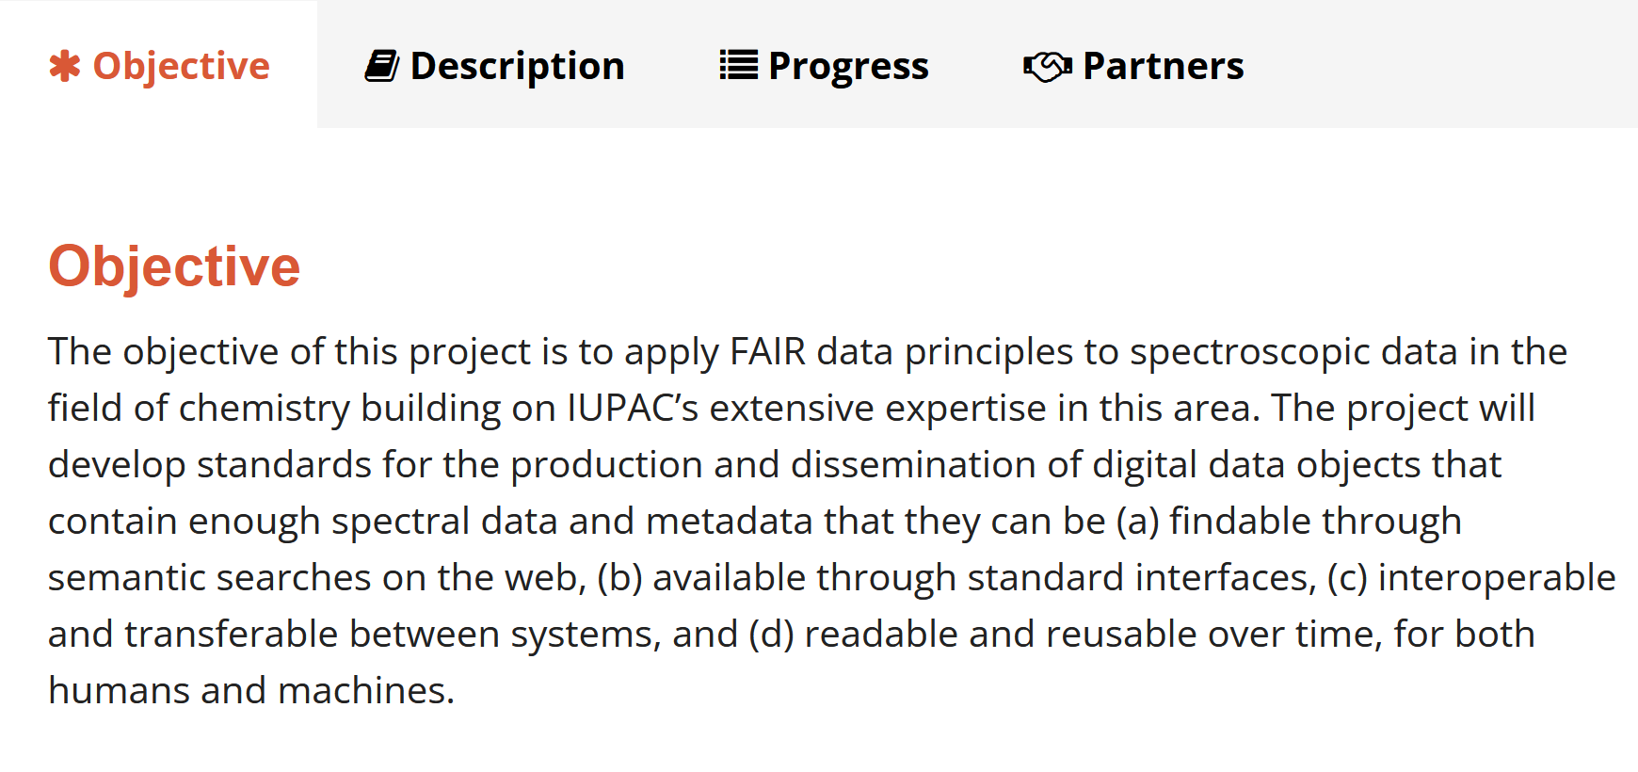

Slide 5
Objectives of the FAIRSpec Project
The proposed standards involve several aspects:
A set of principles underlying what we mean by "FAIR" in relation to spectroscopic data.
A detailed object model for describing the contents and relationships within a generalized “IUPAC FAIRData Collection"
A standard for describing properties and relationships of digital objects within the metadata records of an “IUPAC FAIRSpec Finding Aid.”
A standard for the serialization of an IUPAC FAIRSpec Finding Aid.
A proposal for methods of data and metadata extraction from “IUPAC FAIRSpec-Ready” aggregations.

Slide 6
Products to Date – Guiding Principles
https://doi.org/10.1515/pac-2021-2009

Slide 7
Products to Date – Guiding Principles
https://doi.org/10.1515/pac-2021-2009

Slide 8
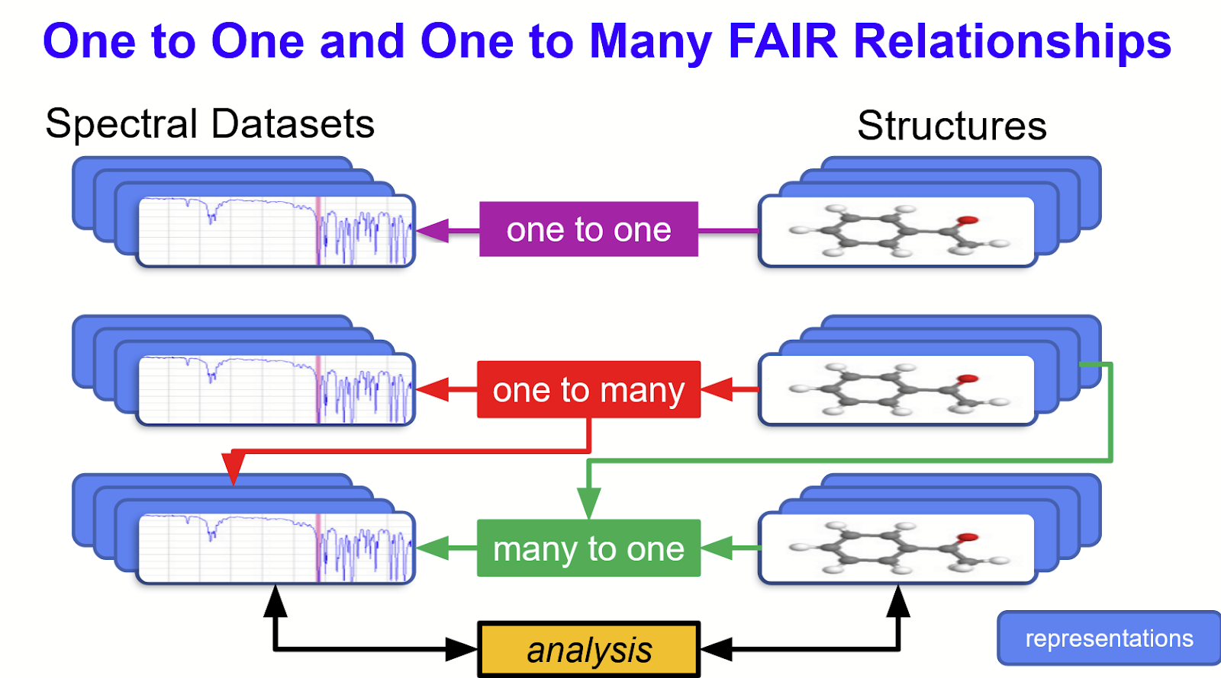
Key Concept: Associations – Relational Metadata

Slide 9
The IUPAC FAIRData Collection – Early On
An IUPAC FAIRData Collection can start off as simply a set of spectra with sample identifiers.
Representations include raw instrument datasets, peak listings, images, etc.

Slide 10
The IUPAC FAIRData Collection
They can be as complex as a collection of experimental spectra with associated samples, chemical structures, predicted spectra, and various analysis objects.

Slide 11
Products to Date – GitHub Project
https://github.com/IUPAC/IUPAC-FAIRSpec
Repository for project digital outputs
Collection of 13 ACS pilot study spectroscopic “supporting data” aggregations
Eclipse open-source Java project
IUPAC FAIRData object model programmatic description and implementation development
IUPAC FAIRSpec Finding Aid serialization development and testing
metadata/data extractor prototyping

Slide 12
Examples of Digital Aggregations
ACS Aggregation | Size (MB) |  | digital entities
 | (zip) | (raw) | files | type
joc.0c00770 | 25 | 37 | 720 | 11 cmpd dirs; 24 Bruker datasets & 12 mnova files
orglett.0c00874 | 27 | 40 | 1616 | 36 cmpd dirs; 76 Bruker datasets
orglett.0c00967 | 29 | 41 | 1354 | 33 cmpd dirs; 62 Bruker datasets
orglett.0c01022 | 15 | 52 | 66 | 2 dirs; 64 mnova files
orglett.0c01197 | 79 | 101 | 61 | 2 dirs; 59 mnova files
orglett.0c01277 | 52 | 74 | 2463 | 63 cmpd dirs; 124 Bruker datasets
orglett.0c01297 | 57 | 73 | 1544 | 29 cmpd dirs; 58 Bruker datasets

Slide 13
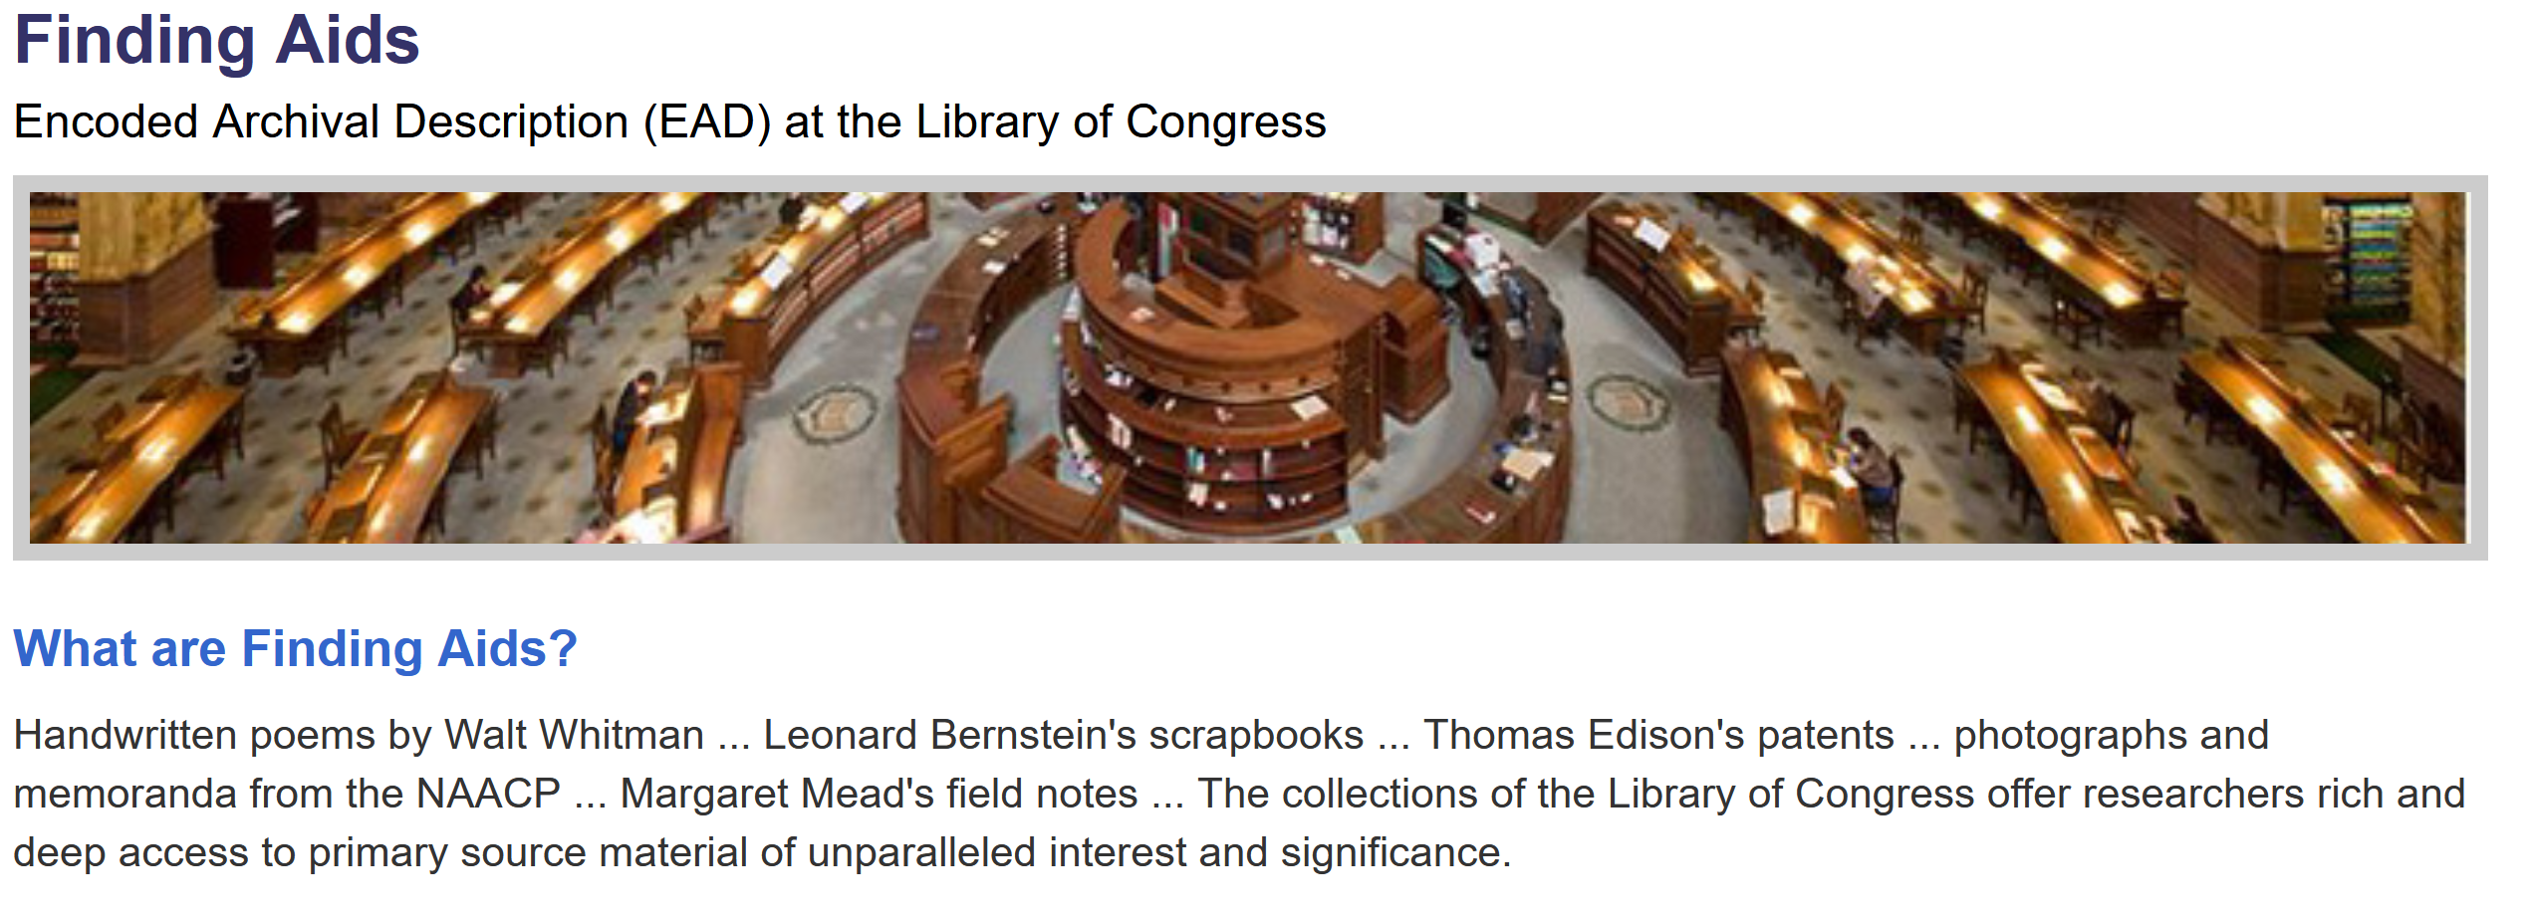
“Finding Aid” Inspiration – EAD
https://www.loc.gov/rr/ead/

Slide 14
Products to Date – Demo Site
https://chemapps.stolaf.edu/iupac/site/ifd4/
Collection of 13 IUPAC FAIRSpec Finding Aids (JSON) and their associated IUPAC FAIRSpec Collections generated by the extractor prototype from the ACS pilot SI data packages.
Small JavaScript library demonstrating (minimal) processing and rendering of the finding aids.

Slide 16
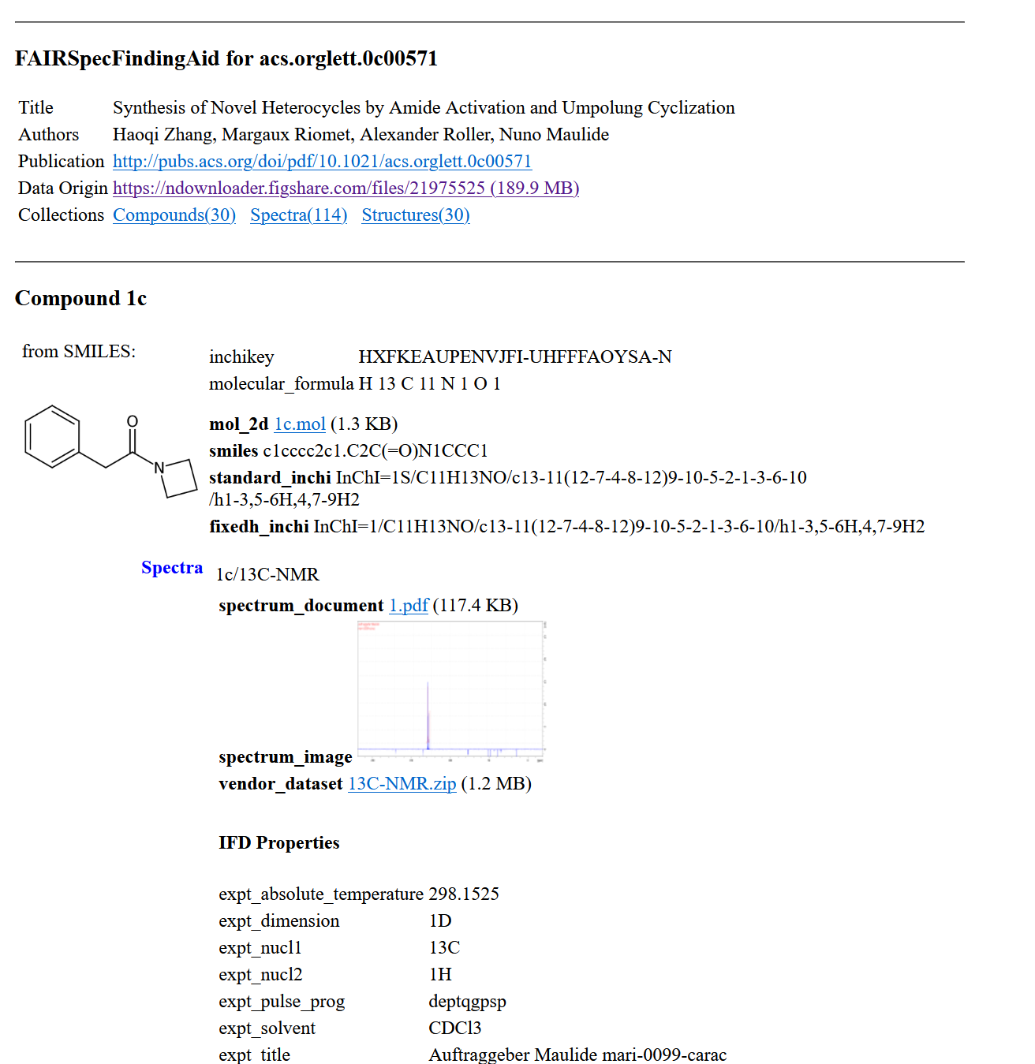

Slide 17
The IUPAC FAIRSpec Finding Aid – Research Mode

Slide 18
The IUPAC FAIRSpec Finding Aid – Publication Mode

Slide 19
The IUPAC FAIRSpec Finding Aid – Deposition Mode
Would provide standardized ingest mechanism for a repository
Would allow pre-ingest validation and error correction
Would allow automated workflow for bulk deposition of datasets
Would interface with systems generating and preserving instrument data

Slide 20
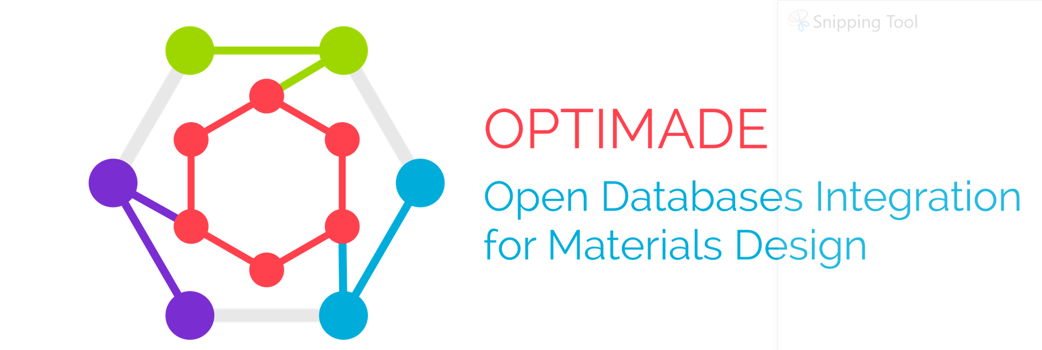
API Inspiration – OPTIMADE
The Open Databases Integration for Materials Design (OPTIMADE) consortium aims to make materials databases interoperable by developing a specification for a common REST API.

Slide 21
The IUPAC FAIRSpec Finding Aid – API Mode
Dissociates data from metadata
Enables efficient browsing, exploration

Slide 22
The IUPAC FAIRSpec Finding Aid – API Mode
Dissociates data from metadata
Enables efficient browsing, exploration

Slide 23
The IUPAC FAIRSpec Finding Aid – Distributed Mode

Slide 24
The IUPAC FAIRSpec Finding Aid – Distributed Mode
Highly flexible
Enables new services

Slide 25
The IUPAC FAIRSpec Finding Aid – Publication Mode
Publication can simply involve pointing to the IUPAC Finding Aid’s landing page.

Slide 26
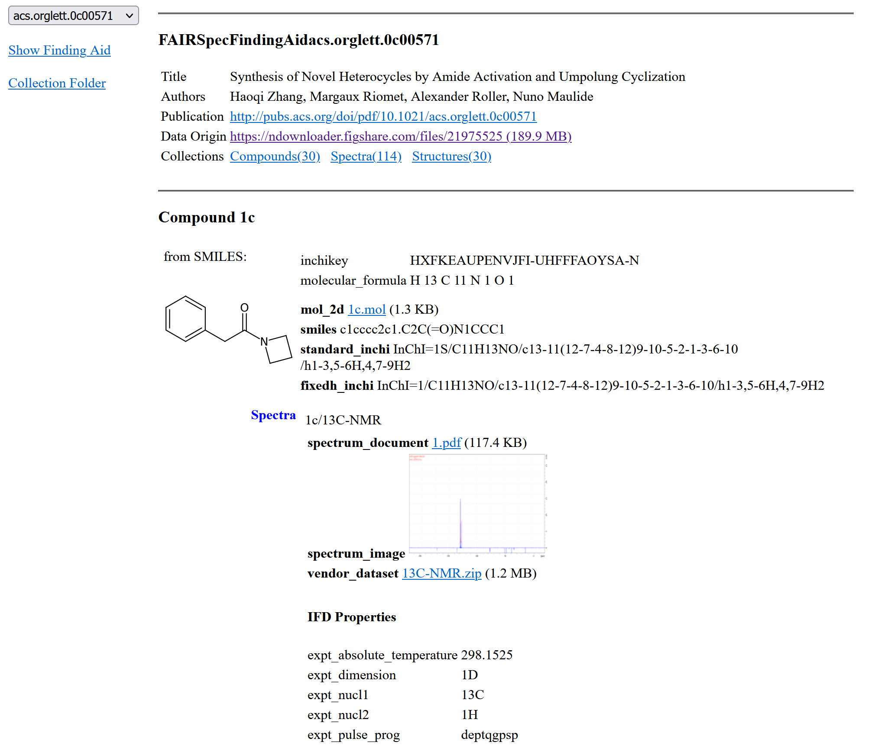

Slide 27
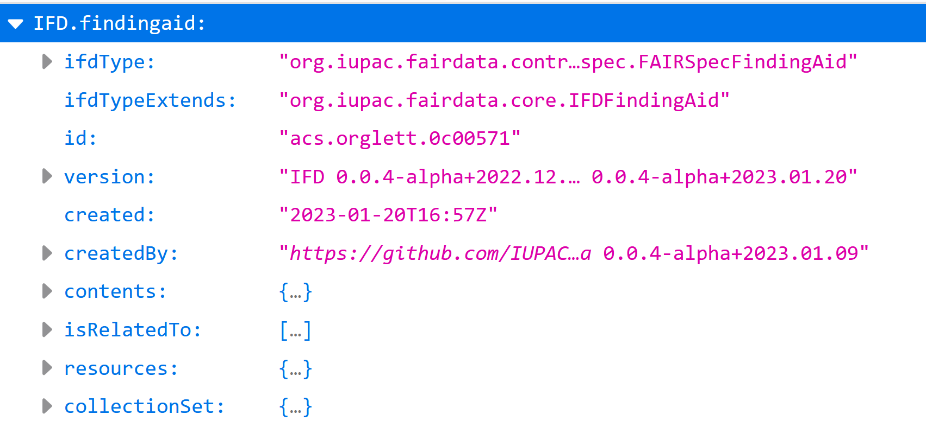
The IUPAC FAIRSpec Finding Aid – A Closer Look
Serializable as JSON
(or XML, in principle)
Highly structured
Object-oriented
Domain/Subdomain-specific
Broadly extensible
Applicable throughout the full data life cycle (and beyond!)
Easily implemented
https://www.loc.gov/rr/ead

Slide 29
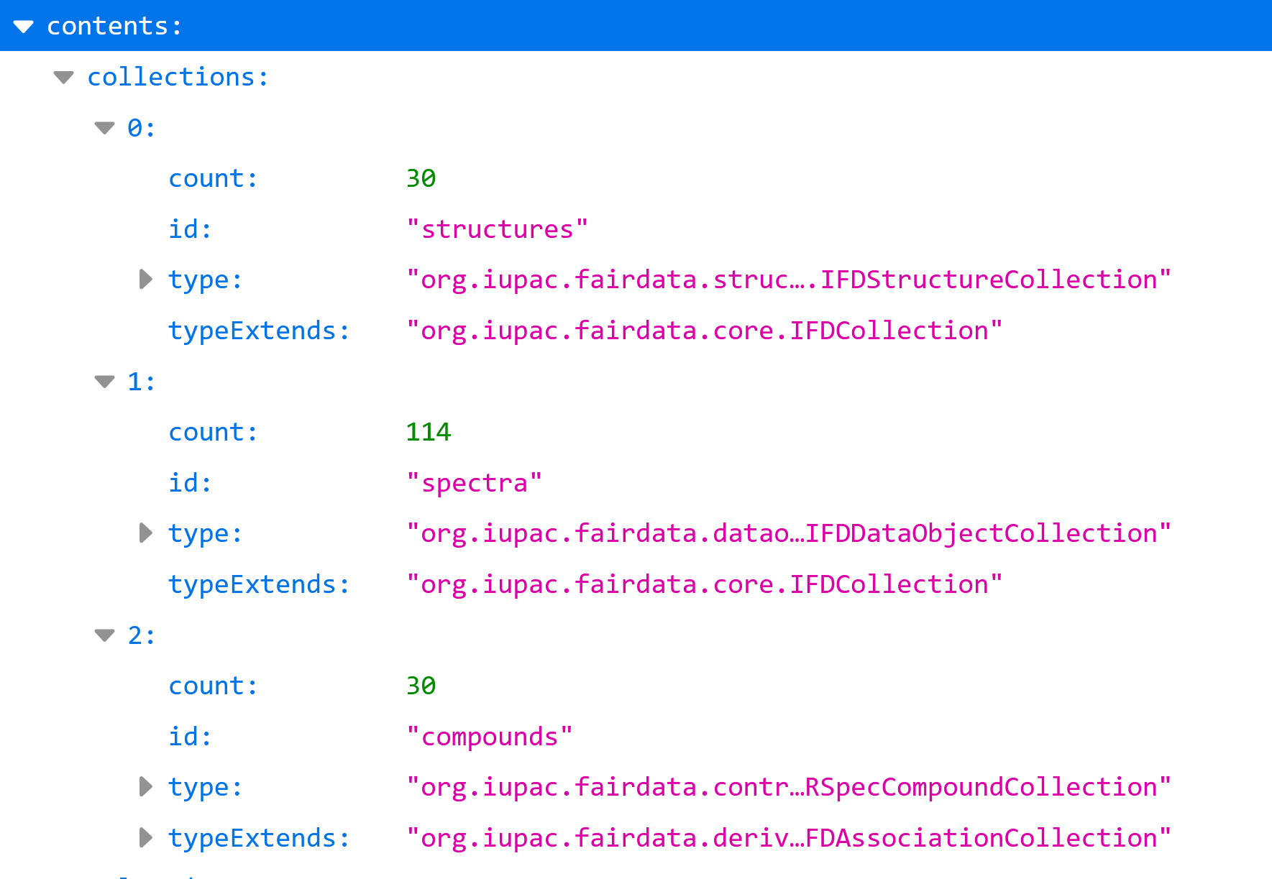

Slide 31
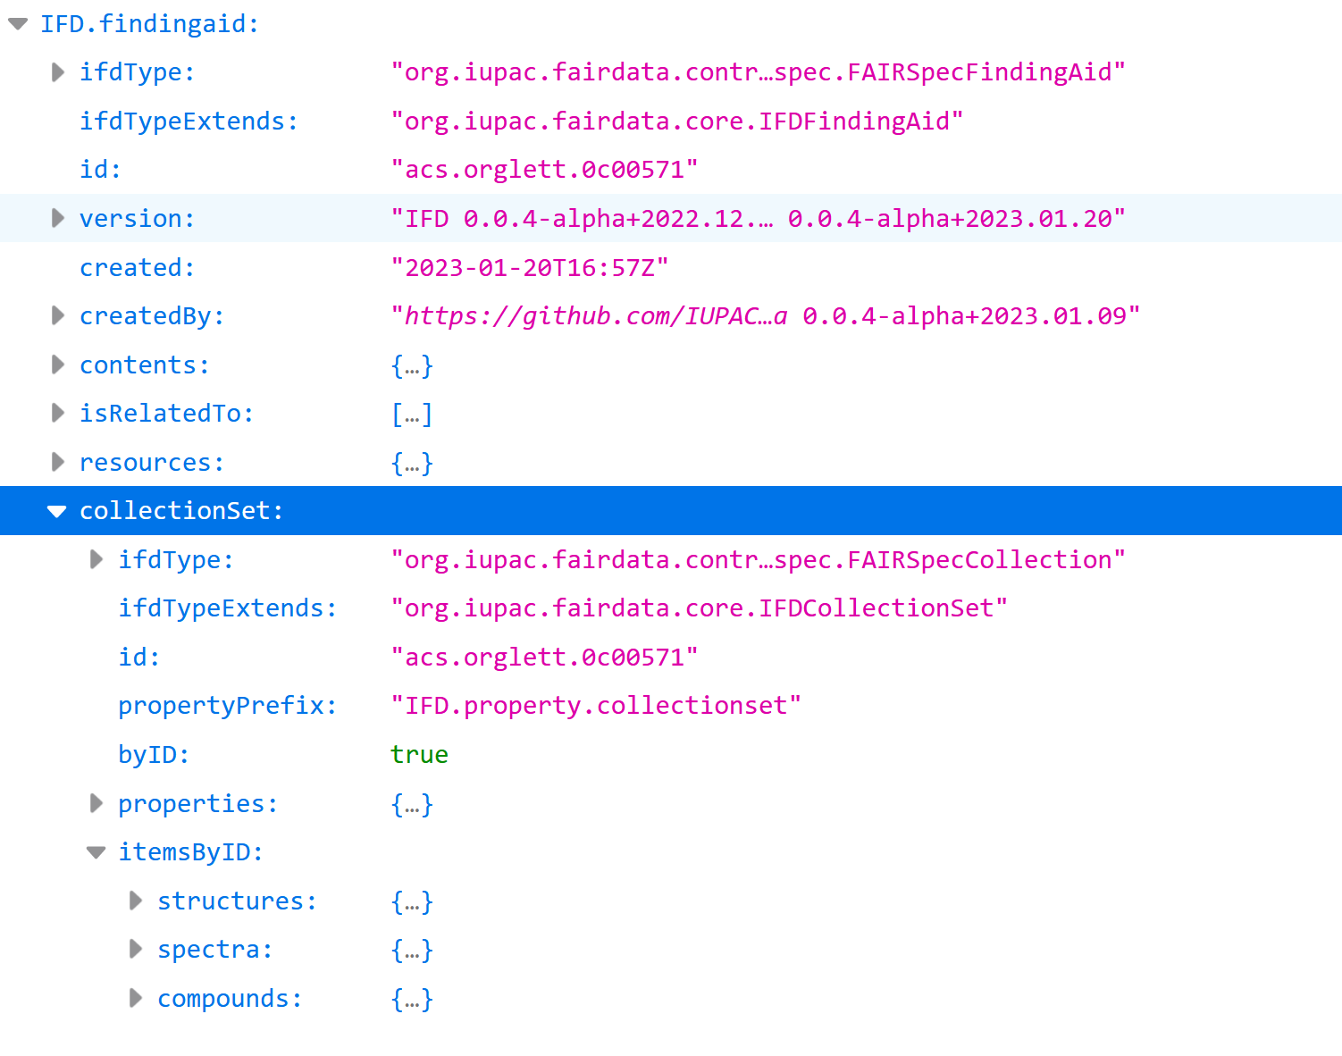

Slide 33
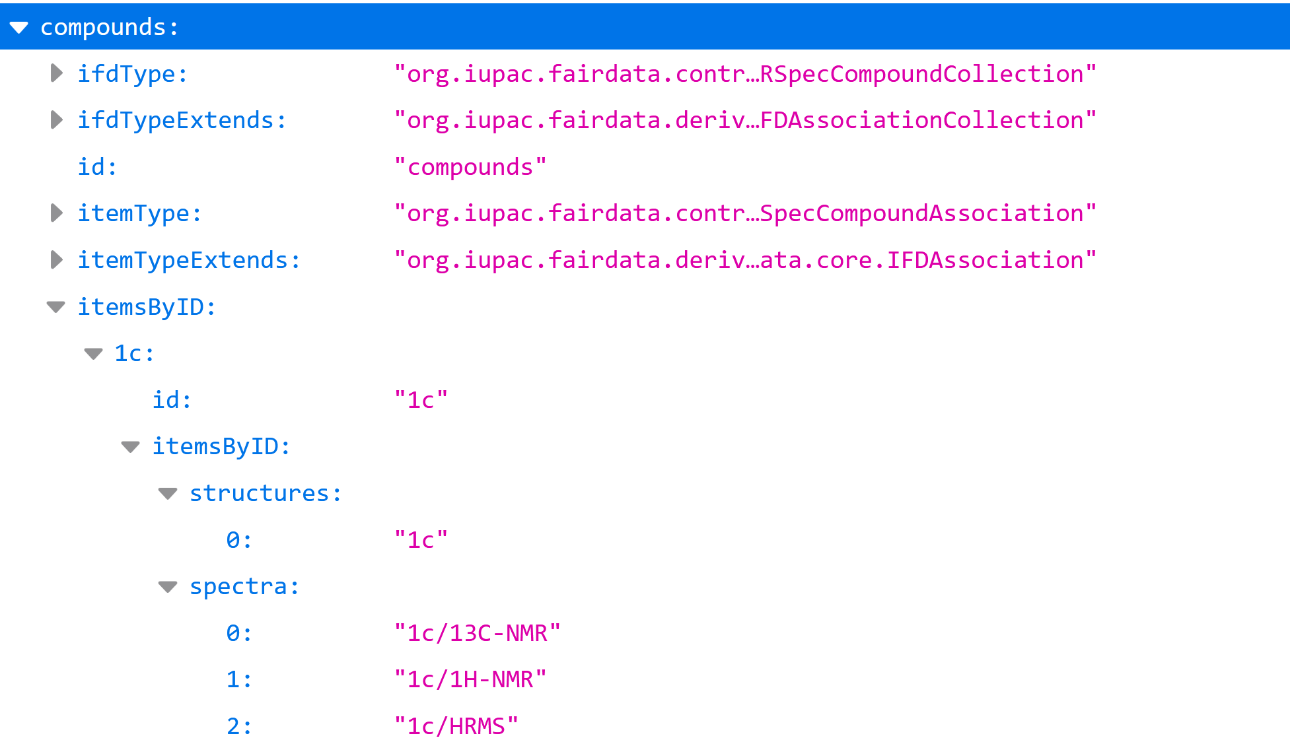

Slide 34
Summary
Spectral data is nothing without a sample identifier or an association with one or more chemical structures. Collections should be valued, not dismembered.

Slide 35
Summary
The developing IUPAC FAIRData Collection Model is capable of describing complex domain-specific relationships between a wide variety data objects.

Slide 36
Summary
The developing IUPAC FAIRSpec Finding Aid Standard is positioned to be the basis for a common protocol for the management and distribution of spectral data and their associated chemical structures throughout the whole data cycle.

Slide 37
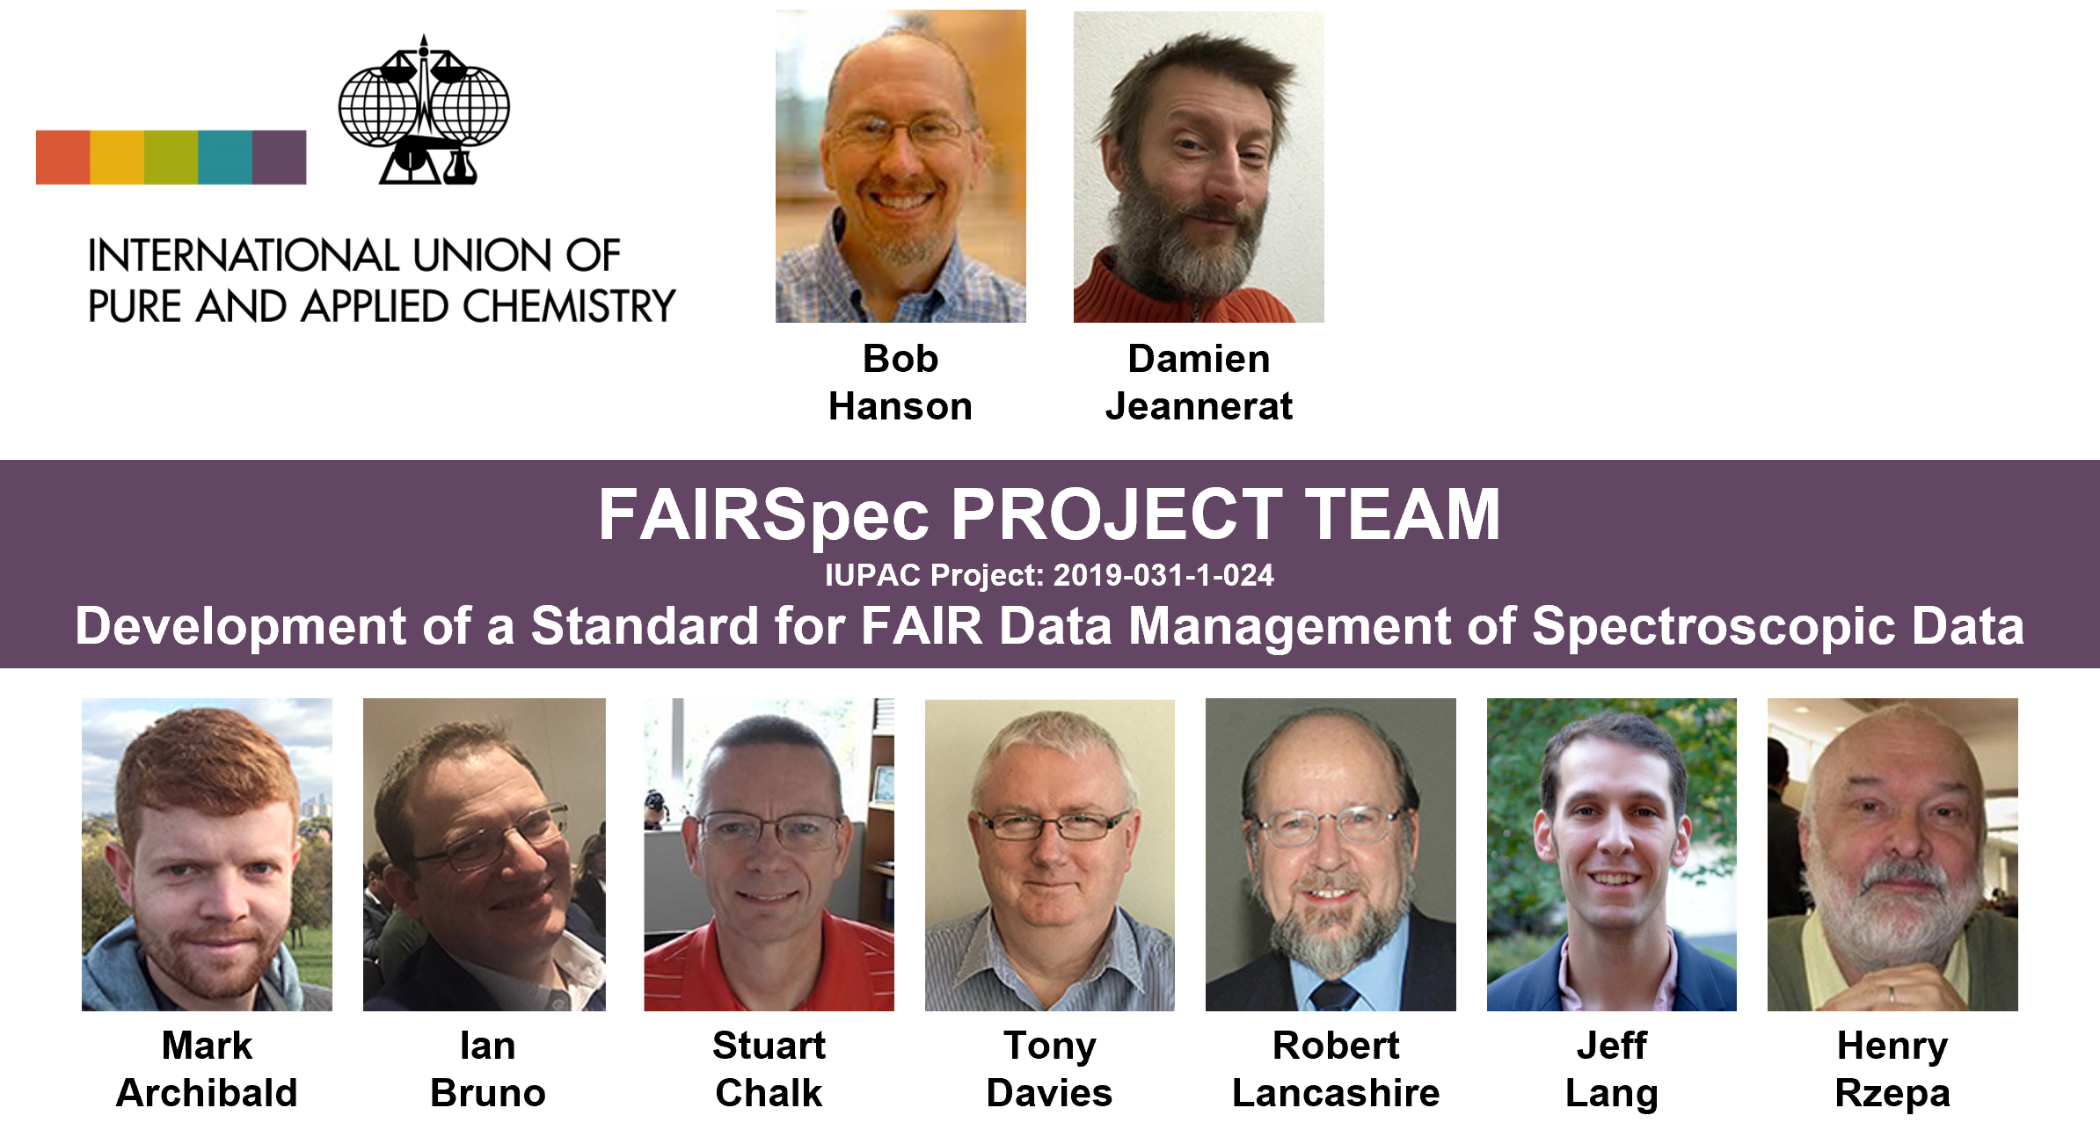
Thank you!
Please join us tomorrow (Monday) afternoon for a discussion
of what it means to be “FAIRSpec-Ready”
IUPAC FAIRSpec-ready collections: Recommendations for researchers, authors, and publishers SESSION: Advancing FAIR Chemistry: Developing New Services for Sharing Chemical Data
2:00 PM - 5:55 PM (in person) Room 112 - Indiana Convention Center

