Slide 1
IUPAC FAIRSpec-ready aggregations: Recommendations for researchers, authors, and publishers
ACS National Meeting, Mar. 27, 2023
Robert M. Hanson, Mark Archibald, Ian Bruno, Stuart J. Chalk, Anthony N. Davies, Damien
Jeannerat, Robert J. Lancashire, Jeff Lang, Henry S. Rzepa
IUPAC Project 2019-031-1-024
Division of Chemical Information: Framing FAIR: Scientific Research Data Sharing Policies, Frameworks and Principles

Slide 2
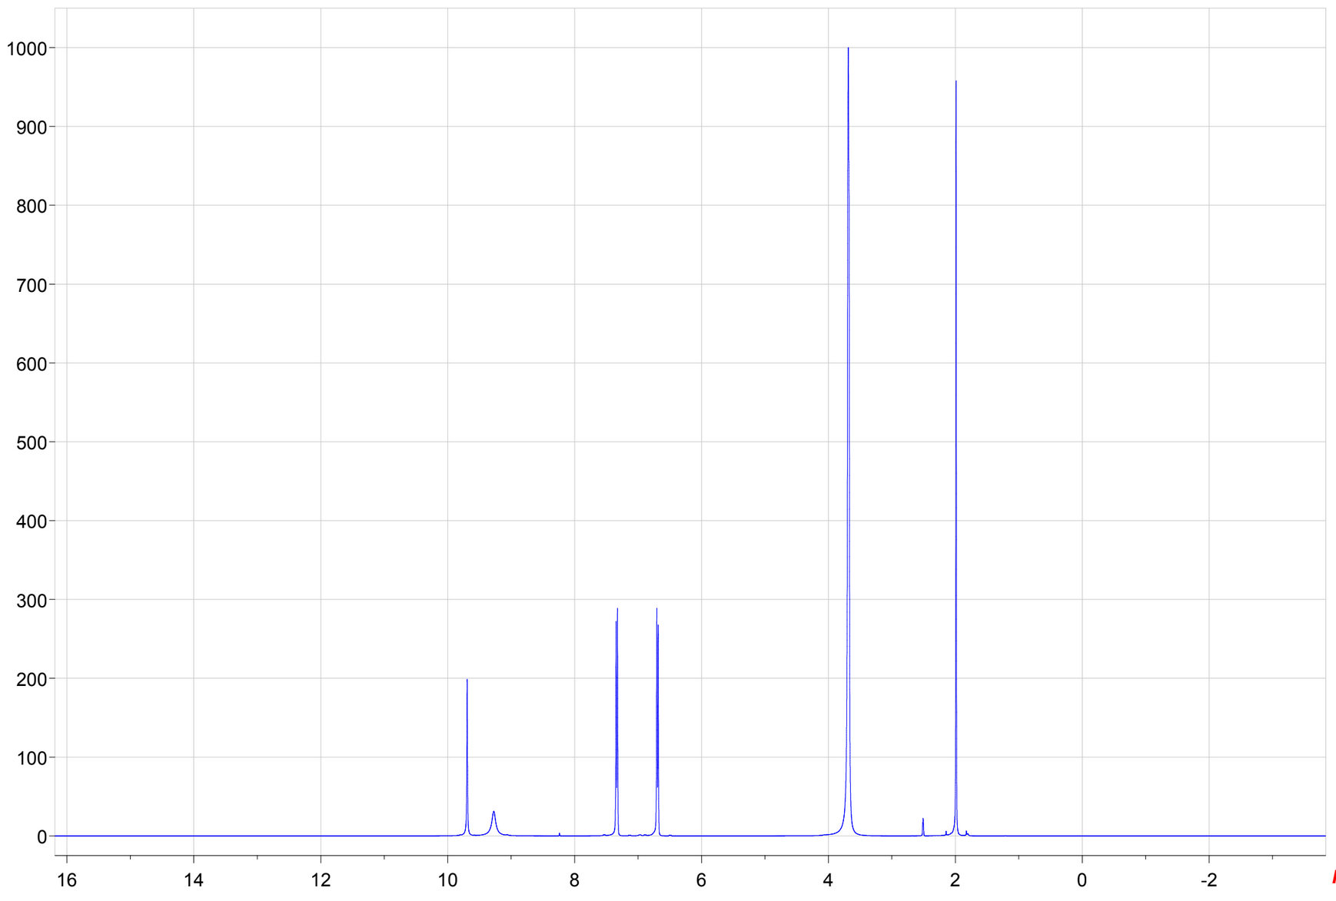
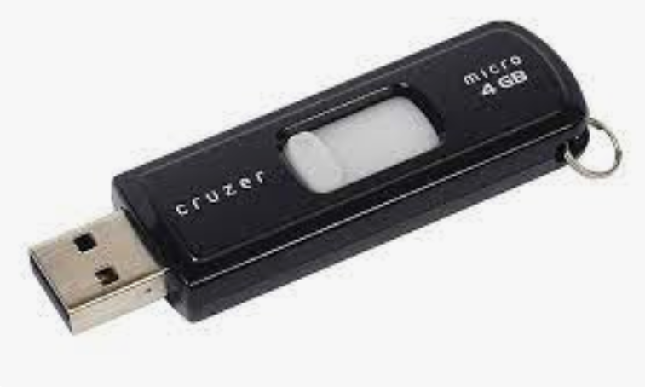
What’s wrong with this picture?

Slide 3
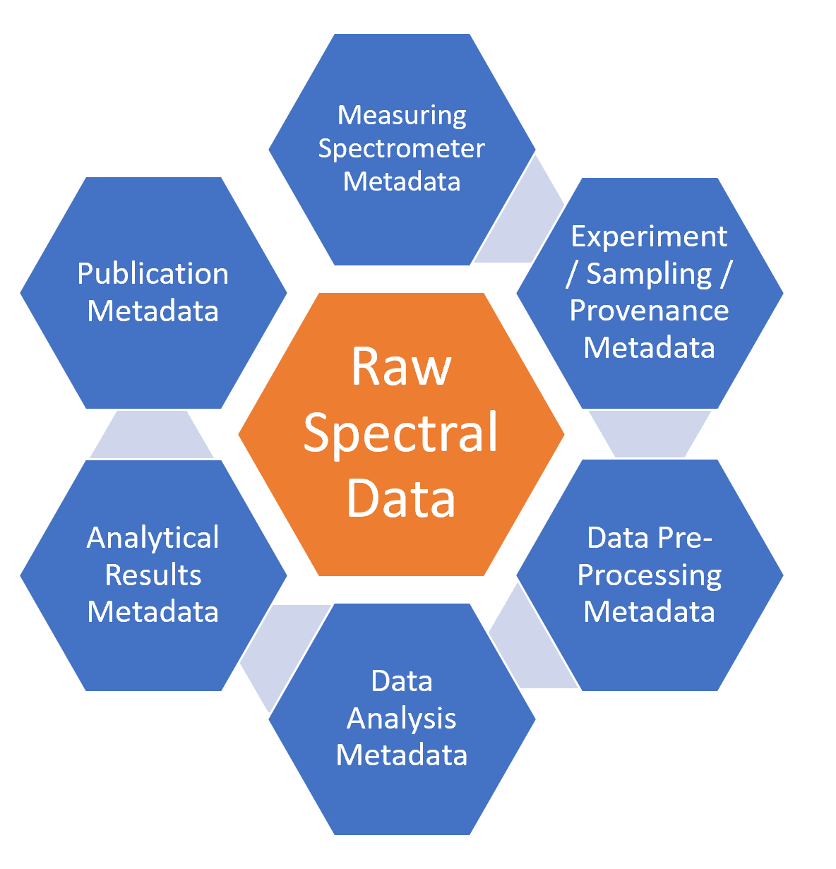
Raw Spectral Data
Measuring Spectrometer Metadata
Experiment / Sampling / Provenance Metadata
Data Pre-Processing Metadata
Data Analysis Metadata
Analytical Results Metadata
Publication Metadata
In an Ideal FAIRSpec World
All metadata would be retained –
Instrument metadata
Dataset provenance
Data preprocessing
Post-acquisition processing
Analysis
Publication information
More?

Slide 4
Raw Spectral Data
Measuring Spectrometer Metadata
Experiment / Sampling / Provenance Metadata
Data Pre-Processing Metadata
Data Analysis Metadata
Analytical Results Metadata
Publication Metadata
In an Ideal FAIRSpec World
And all this (and the data set itself!) would be findable.

Slide 5
Raw Spectral Data
Measuring Spectrometer Metadata
Experiment / Sampling / Provenance Metadata
Data Pre-Processing Metadata
Data Analysis Metadata
Analytical Results Metadata
Publication Metadata
In an Ideal FAIRSpec World
And all this (and the data set itself!) would be findable.
By humans and machines.
FAIR == “Fully Artificial Intelligence Ready”

Slide 6
Raw Spectral Data
Measuring Spectrometer Metadata
Experiment / Sampling / Provenance Metadata
Data Pre-Processing Metadata
Data Analysis Metadata
Analytical Results Metadata
Publication Metadata
Just to be clear…
We are not here to talk about "FAIR data".
We are here to talk about the FAIR management of data.

Slide 7
FAIR data management is a continuous process
Local Global

Slide 8
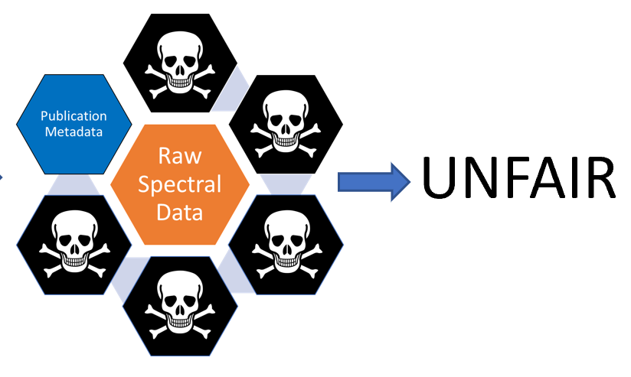
What we have here is a recipe for data and metadata death!

Slide 9
Bob Hanson
Damien Jeannerat
FAIRSpec PROJECT TEAM
IUPAC Project: 2019-031-1-024 Development of a Standard for FAIR Data Management of Spectroscopic Data
Mark Archibald
Ian Bruno
Stuart Chalk
Tony Davies
Robert Lancashire
Jeff Lang
Henry Rzepa

Slide 10
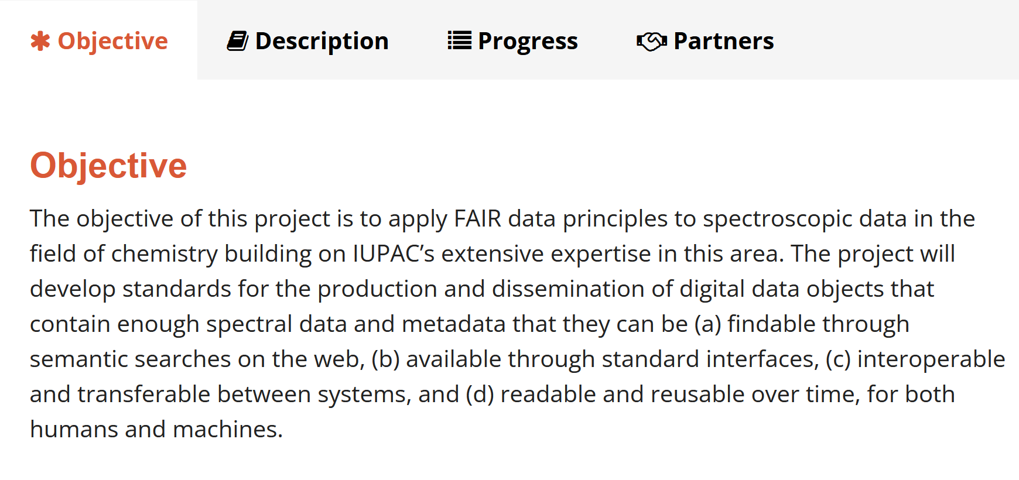

Slide 11
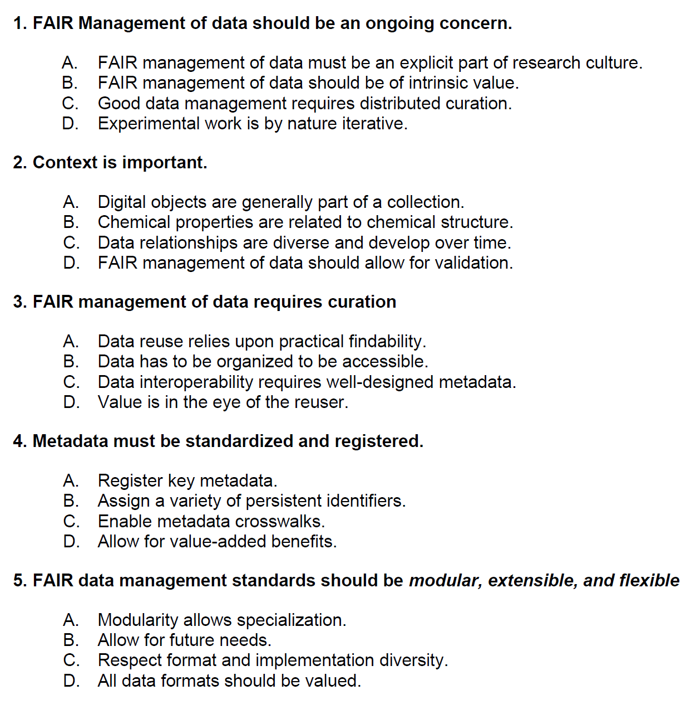
Guiding Principles for the FAIR Management of Spectroscopic Data
IUPAC Specification for the FAIR Management of Spectroscopic Data in Chemistry (IUPAC FAIRSpec) - Guiding Principles
Robert M. Hanson, Damien Jeannerat, Mark Archibald, Ian Bruno, Stuart J. Chalk, Antony N. Davies, Robert J. Lancashire, Jeffrey Lang and Henry S. Rzepa
Pure and Applied Chemistry, 2022
https://doi.org/10.1515/pac-2021-2009

Slide 12
IUPAC FAIRSpec Principles
1. FAIR Management of data should be an ongoing concern.
A. FAIR management of data must be an explicit part of research culture.
B. FAIR management of data should be of intrinsic value.
C. Good data management requires distributed curation.
D. Experimental work is by nature iterative.
What it means to be FAIRSpec Ready:
Don’t wait until publication time to organize your data!
Recognize the ongoing value of well-organized data.
Find (or create!) the right tools for the job.
Allow for corrections and addition of new information.

Slide 13
IUPAC FAIRSpec Principles
2. Context is important.
A. Digital objects are generally part of a collection.
B. Chemical properties are related to chemical structure.
C. Data relationships are diverse and develop over time.
D. FAIR management of data should allow for validation.
What it means to be FAIRSpec Ready:
Recognize context – a day’s work, a project, a team effort.
Associate spectra with chemical structure, if you can.
Allow for ambiguity and reconsideration of these associations.
Find ways to validate your structural and spectral analysis.

Slide 14
IUPAC FAIRSpec Principles
3. FAIR management of data requires curation.
A. Data reuse relies upon practical findability.
B. Data has to be organized to be accessible.
C. Data interoperability requires well-designed metadata.
D. Value is in the eye of the reuser.
What it means to be FAIRSpec Ready:
You are going to have to part of the work.
Optimize opportunities for data citation.
Do not presume to know how people will utilize your data.

Slide 15
IUPAC FAIRSpec Principles
4. Metadata must be registered and standardized.
A. Register key metadata.
B. Assign a variety of persistent identifiers.
C. Enable metadata crosswalks.
D. Allow for value-added benefits.
What it means to be FAIRSpec Ready:
Findability relies upon proper registration.
This is not necessarily something you have to do yourself.
Professionals in your organization will be involved.
Your publisher will be involved.

Slide 16
IUPAC FAIRSpec Principles
5. FAIR data management standards should be modular, extensible, and flexible.
A. Modularity allows specialization.
B. Design to adapt to future needs.
C. Respect digital diversity.
D. All data formats should be valued.
What it means to be FAIRSpec Ready:
How can we make this as simple for you as possible?
How can we make this useful to you now?
We need your input!

Slide 17
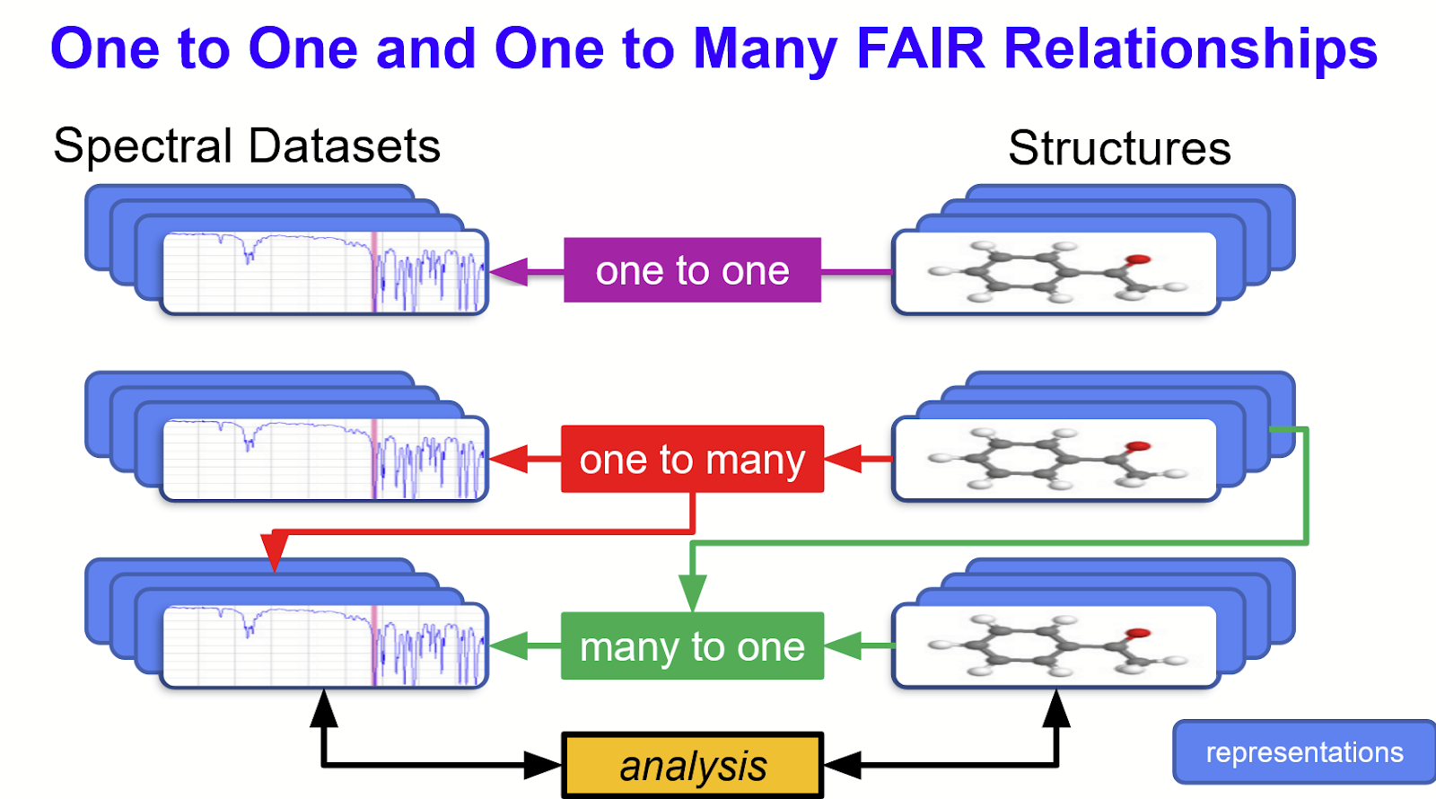
Key Concept: Associations – Relational Metadata

Slide 18
Two kinds of metadata
Descriptive metadata
The solvent used
The instrument manufacturer
The type of the representation (raw data set, image, peak listing; MOL file, SMILES, InChI)
Relational metadata
The associations among sample, structure, spectrum, and analysis within a collection
The relation of this collection to other data collections
The relation of this collection to other works (lab notebook, group project, publication)

Slide 19
Two kinds of metadata
Descriptive metadata
The solvent used
The instrument manufacturer
The type of the representation (raw data set, image, peak listing; MOL file, SMILES, InChI)
Relational metadata
The associations among sample, structure, spectrum, and analysis within a collection
The relation of this collection to other data collections
The relation of this collection to other works (lab notebook, group project, publication)
Descriptive metadata embedded in datasets and structure file formats is a starting point and can be easily “extracted” using automation.
Relational metadata is the real challenge.

Slide 20
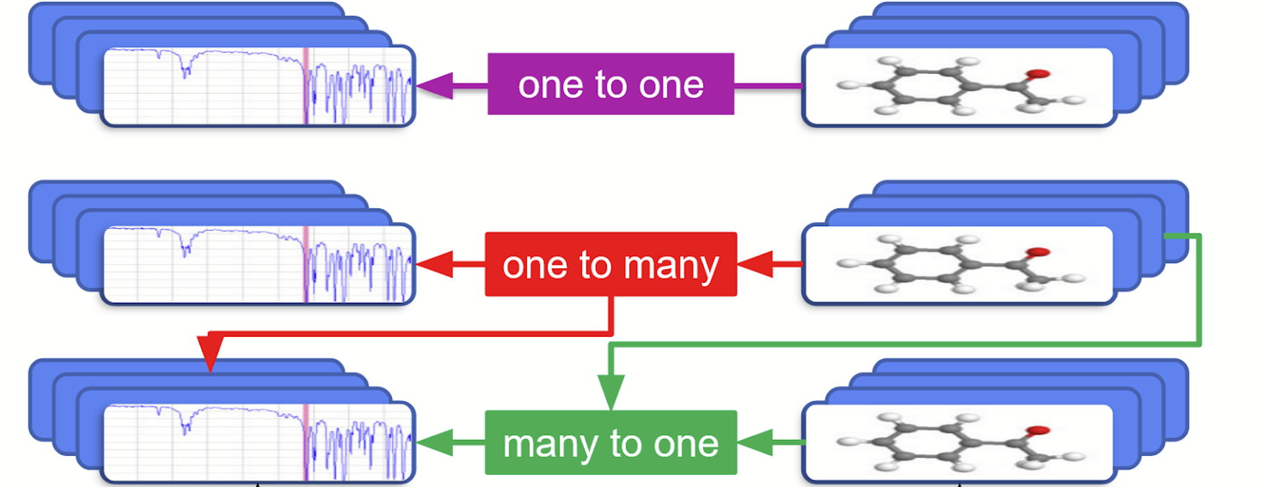
We need to know...
What compound (or at least sample) is associated with this spectrum?
What (do you think) is the structure of that compound?

Slide 21
Curation workflow
The starting point is a well-organized FAIRSpec-Ready data aggregation.

Slide 22
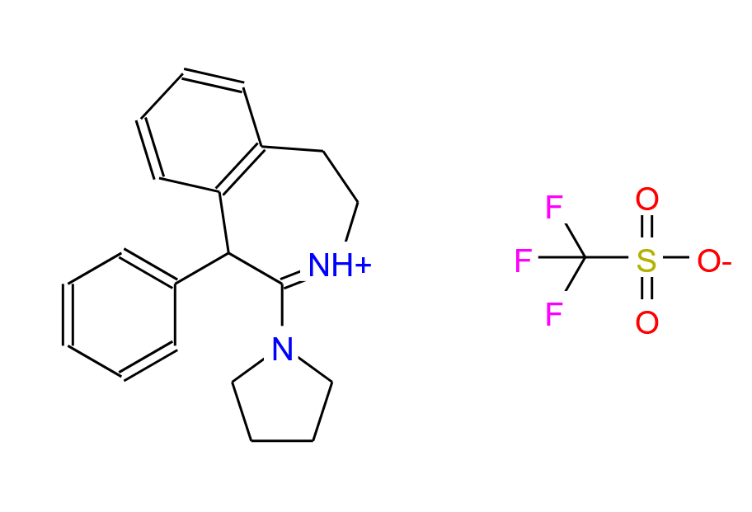
Curation workflow
Automated extraction gets us more structure representations…
for example, SMILES, InChI, and PNG image representations.

Slide 23
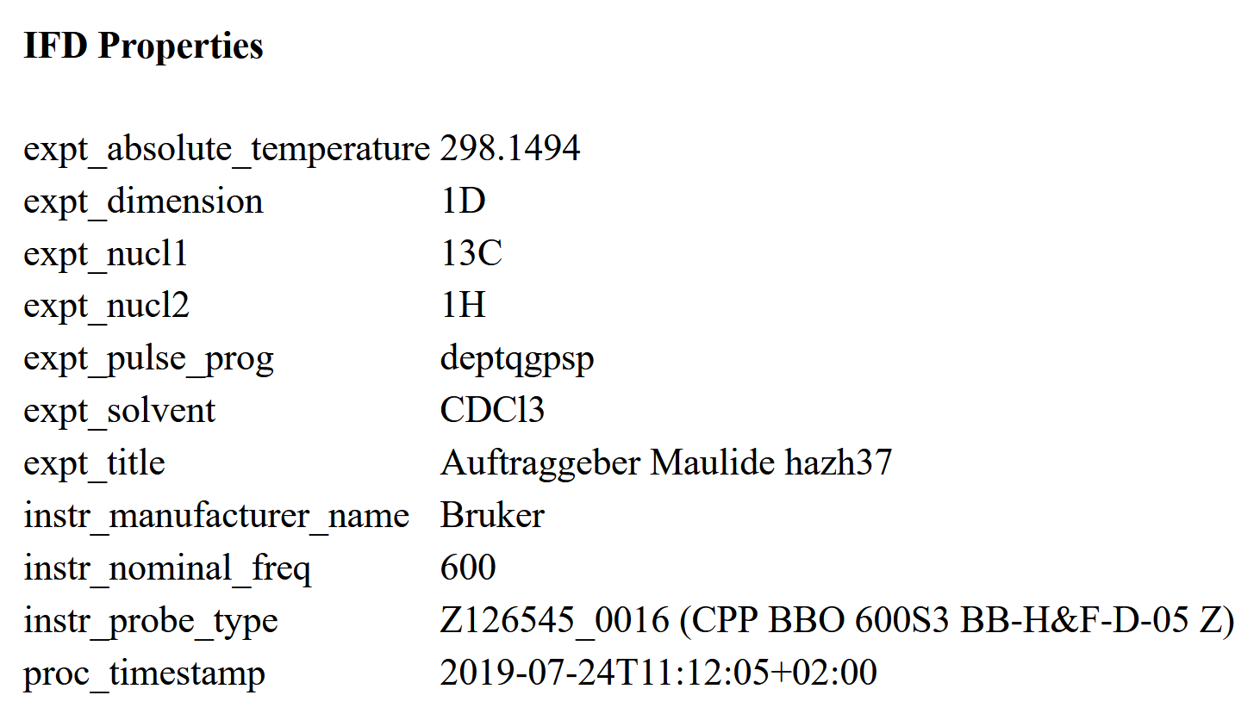
Curation workflow
…and pulls out metadata relating to the experiments…

Slide 24
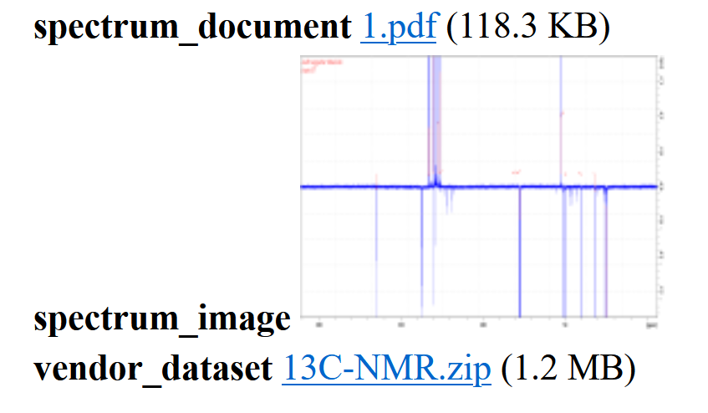
Curation workflow
…as well as multiple spectral data representations

Slide 25
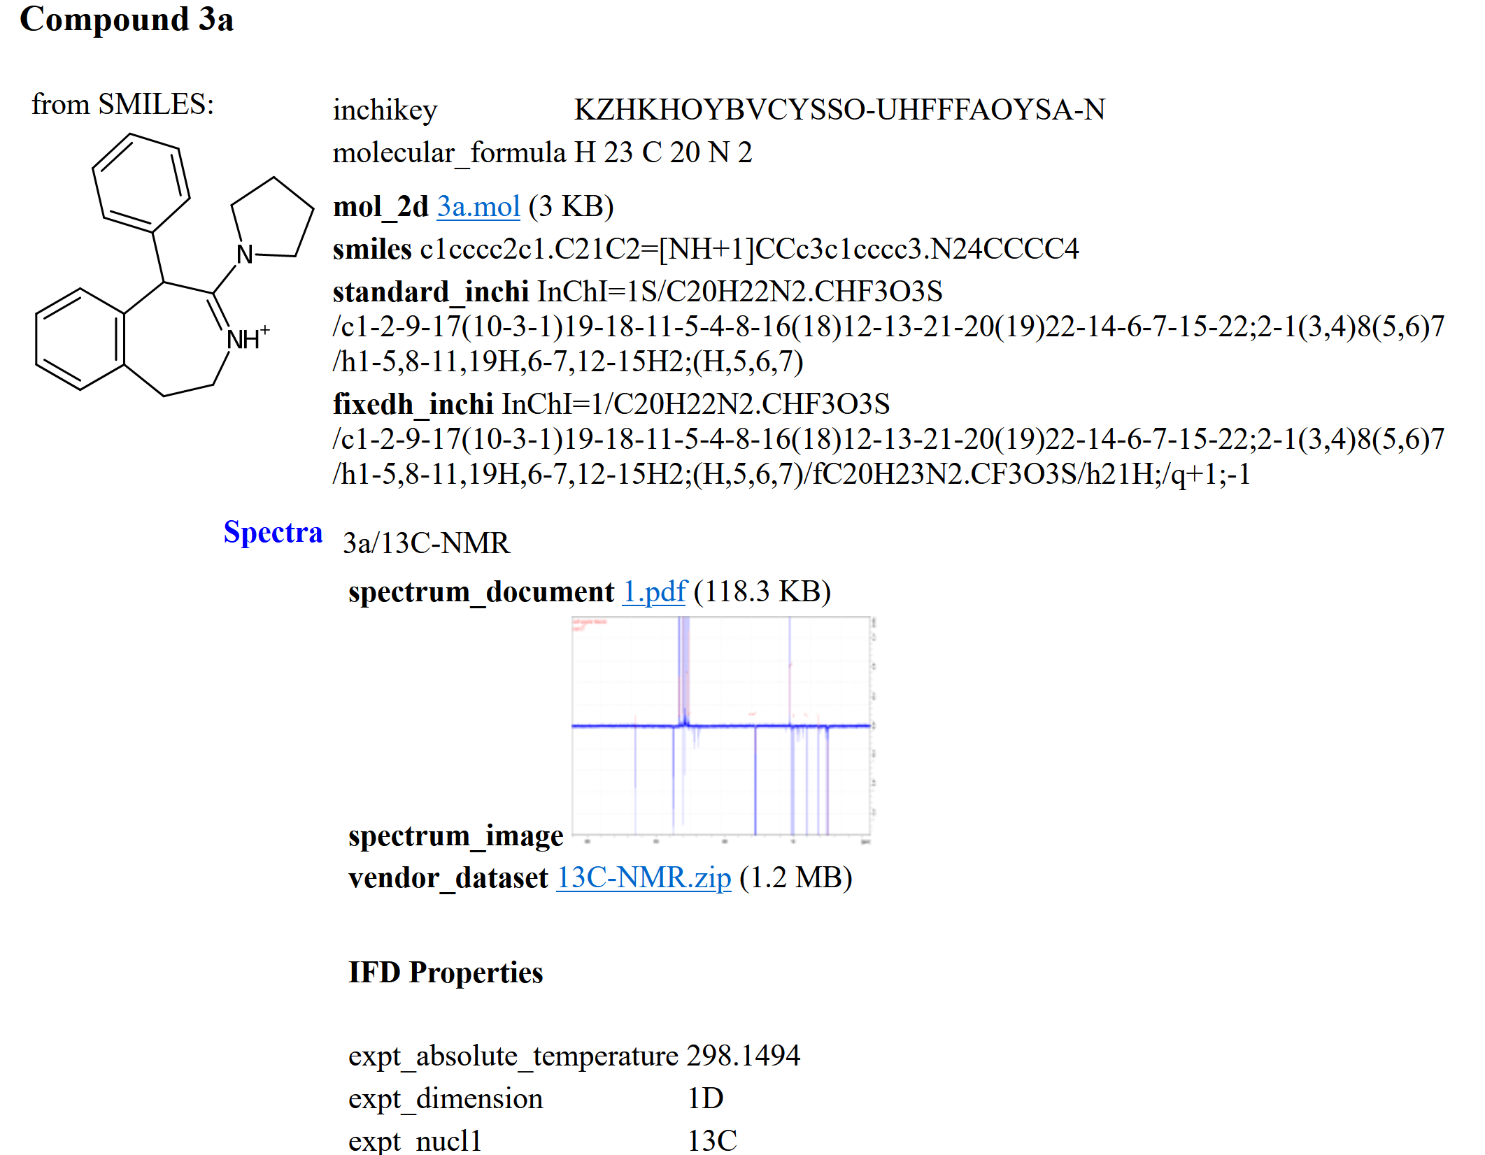
Curation workflow
The Finding Aid can be read by stand-alone or browser-based applications
allowing for early-stage
error correction as well as
local structure, substructure,
and spectroscopic metadata
browsing.

Slide 26
Curation workflow
A public version of the collection and its finding aid can be placed in a repository, given a persistent identifier, connected to a publication, and cited.

Slide 27
In Summary
IUPAC FAIRSpec standardization
simplifies project management
provides better continuity of group knowledge
enables local or remote real-time structure-data validation
allows distributed access to distributed data
allows for private as for public collections
enables standardization of communication between systems (ELN/LMS/repository deposition and query/author-publisher)
provides more citation pointers to publications and other citable objects
allows for "above the value line" innovation

Slide 28
Break-Out Room Discussion
Focus on “FAIRSpec-Ready”
Discuss these ideas in an informal format, with reference to the slides
Interactively explore finding aids from the ACS pilot study
Discuss problematic issues, concerns, complications
Brainstorm on possible funding possibilities for future implementation
We’re here to listen!!
Thank you!

